Slide 1


Appliance Energy Use Alexis Kaldany Time Series Term Project Overseen by Professor R. Jafari April 22,2022

Slide 2
Table of Contents
Descriptive Statistics
Differencing and Log-Diff
Seasonality
Base Models
Linear Regression and Backwards Selection
GPAC
ARMA (3,0)
ARMA(3,3)
SARIMA (ARIMA(3,0,0)x(0,3,0,12))
LSTM
Overview of Model Results
Conclusion
Citations

Slide 3
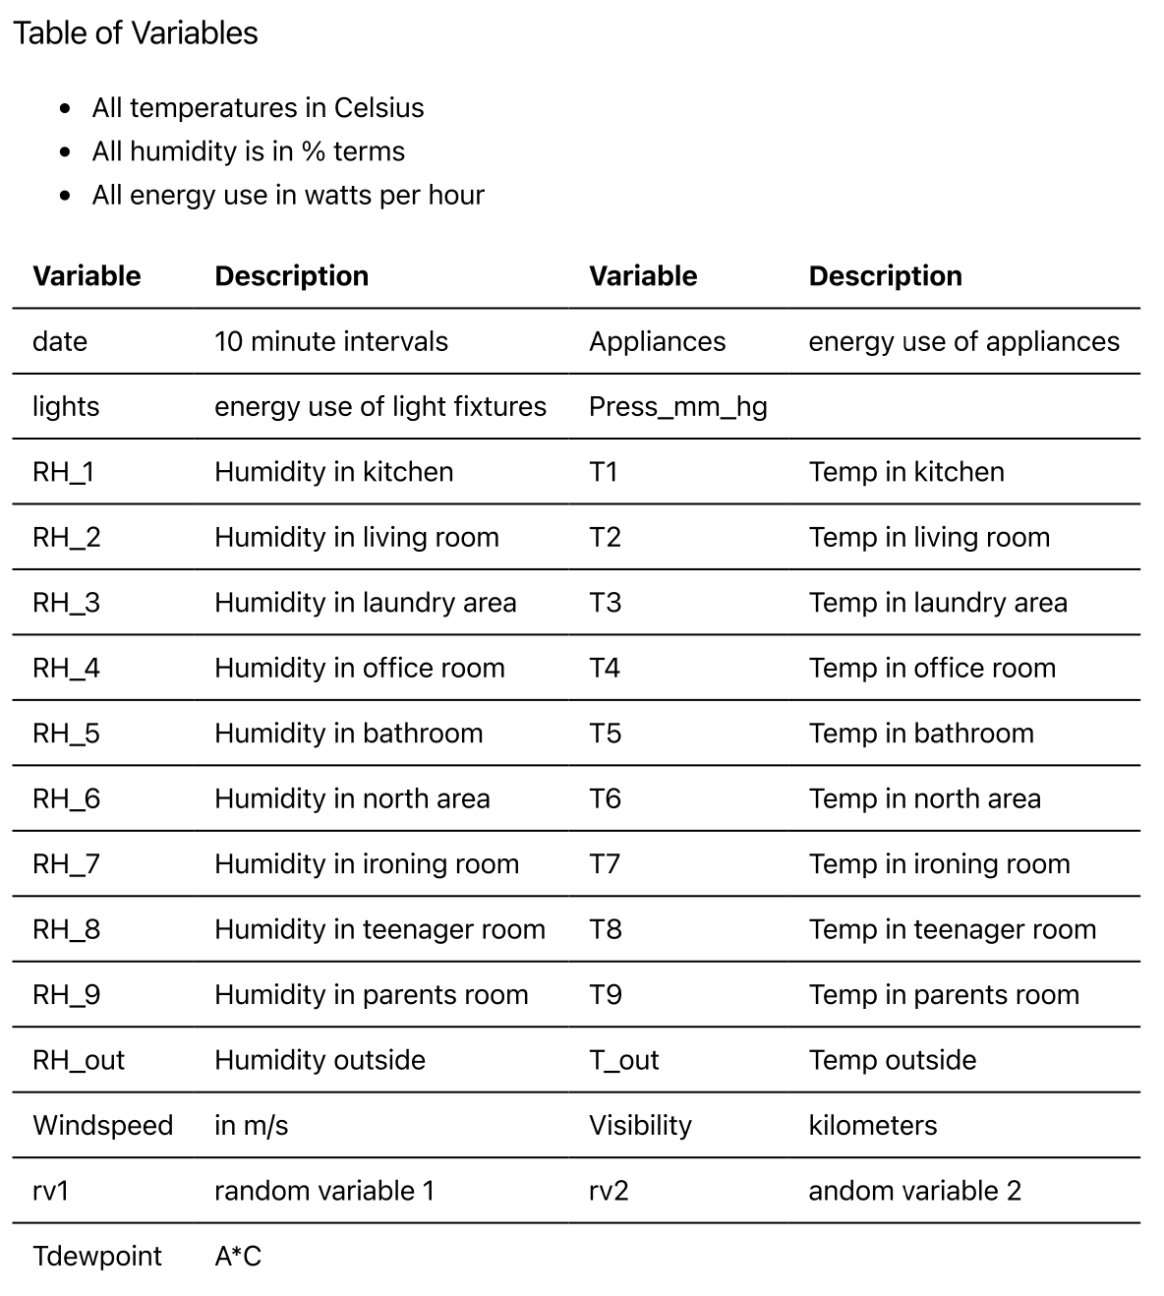
Dataset is composed on 26 variables.
Dependent variable is “Appliances”, which measures energy use of appliances in the home.
All variables have a 10 minute time step.
144 time step is equal to one day.
Rv1 and rv2 are random variables and do not have predictive power.
Temperature and humidity are observed in various places in the home.
Additional variables pertaining to the weather are calculated outside.

Slide 4
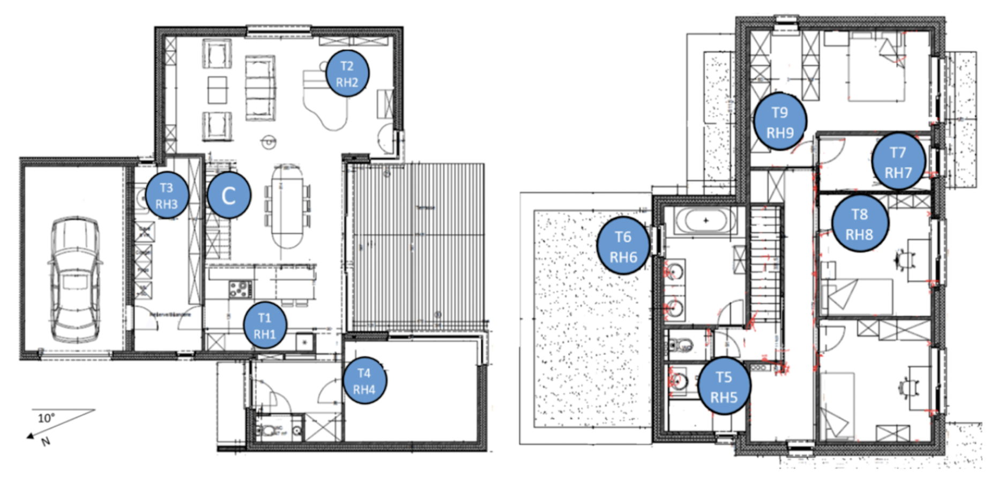
Location of variables within the home

Slide 5
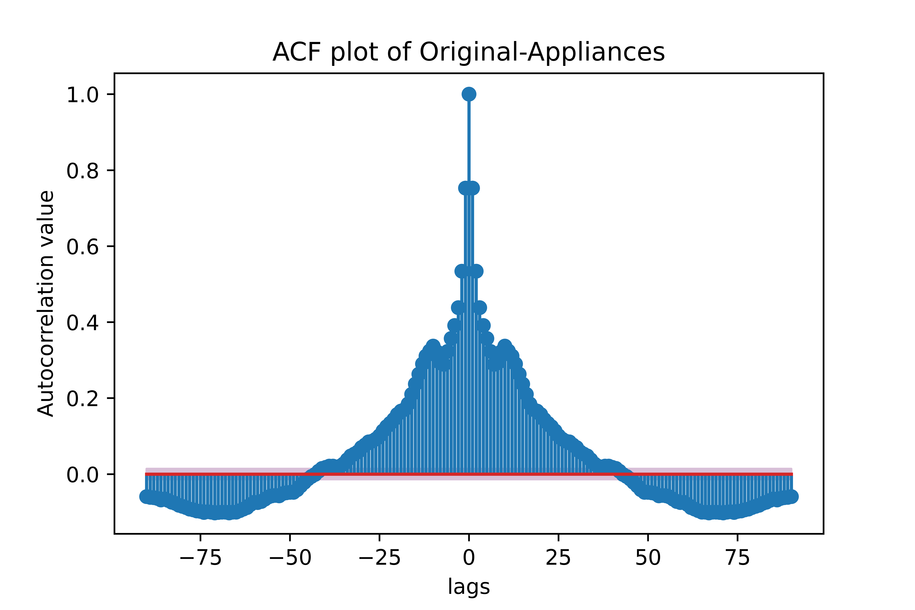
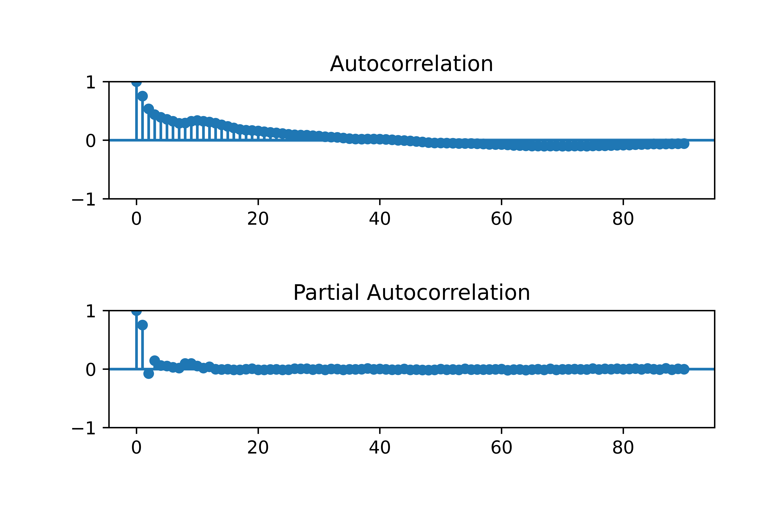
Original Undifferenced plot
ACF and PACF of undifferenced data
Based on the plot there is clearly spikes in energy usages, and then a return to zero use.
Energy use sits at ~0.0 then spikes all the way to 1000 at times.
The ACF looks like there is some AR terms because of the relative smoothness over the 90 lags.
The PACF shows a little bit of MA ordering.

Slide 6
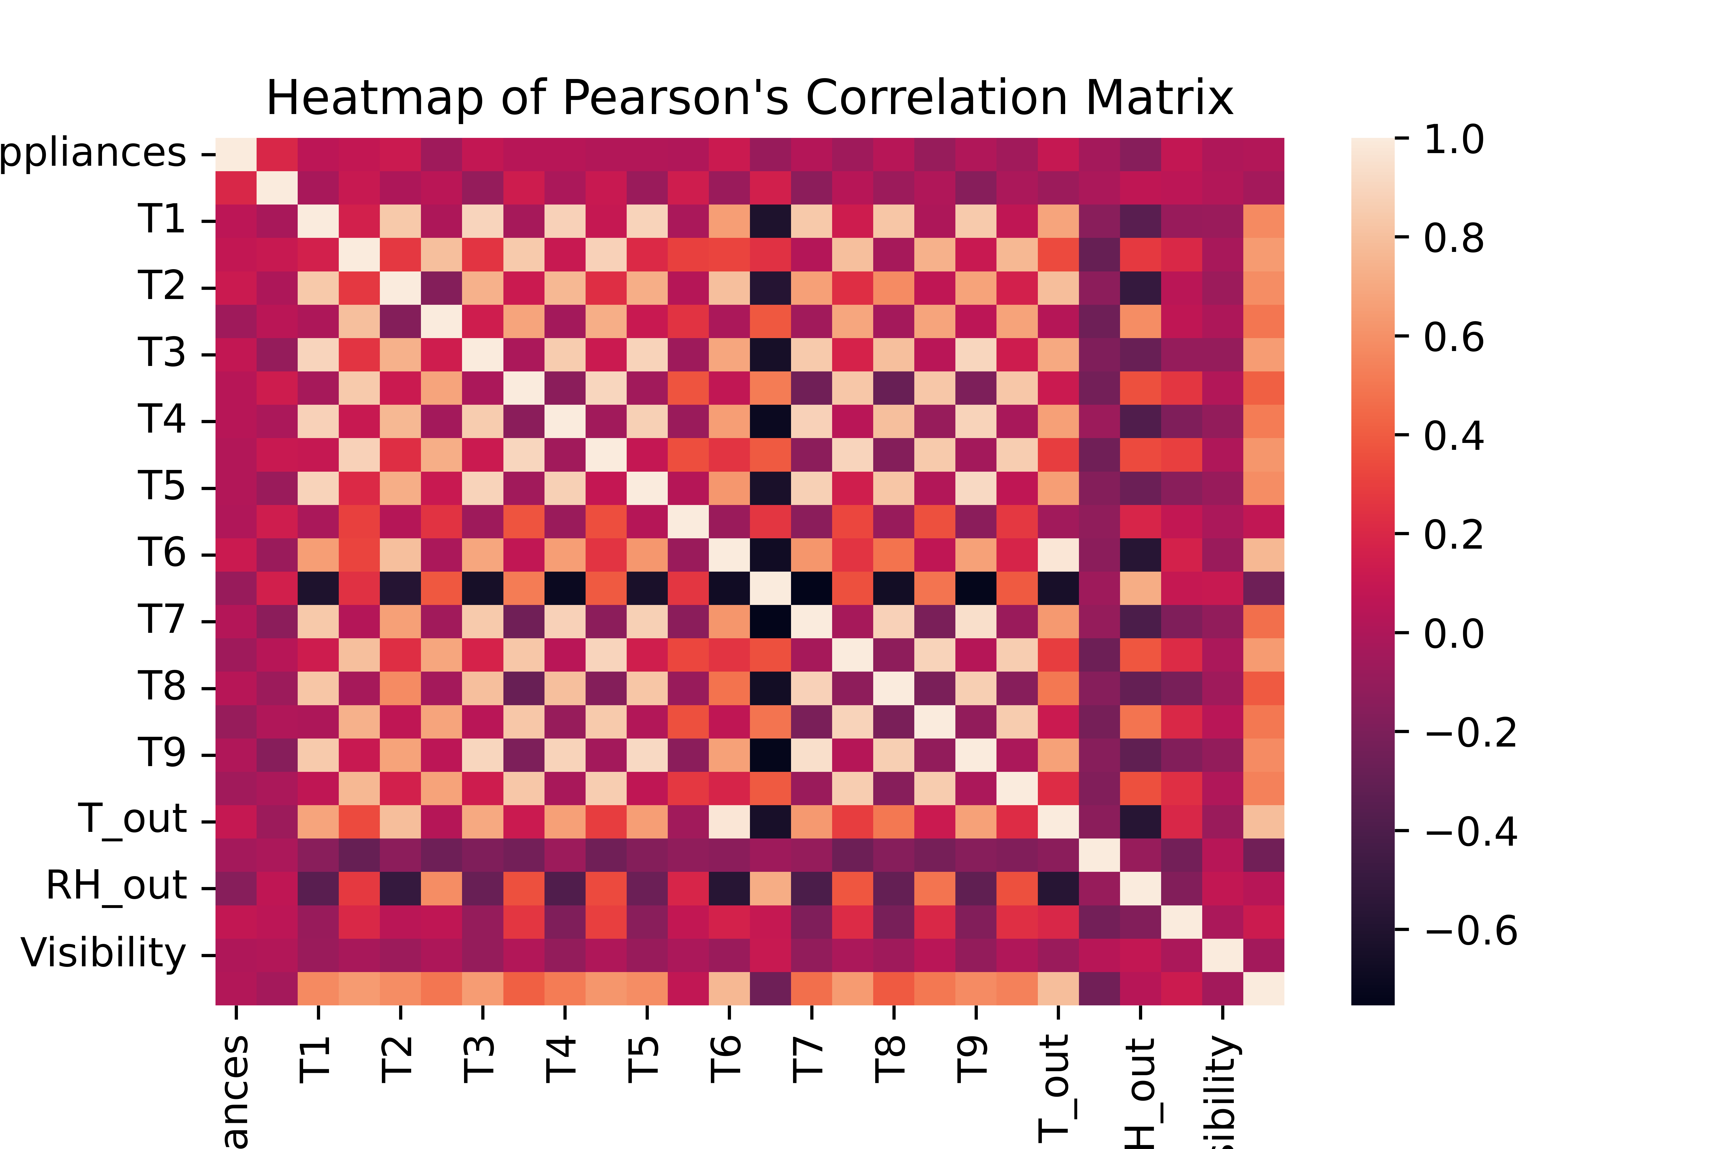
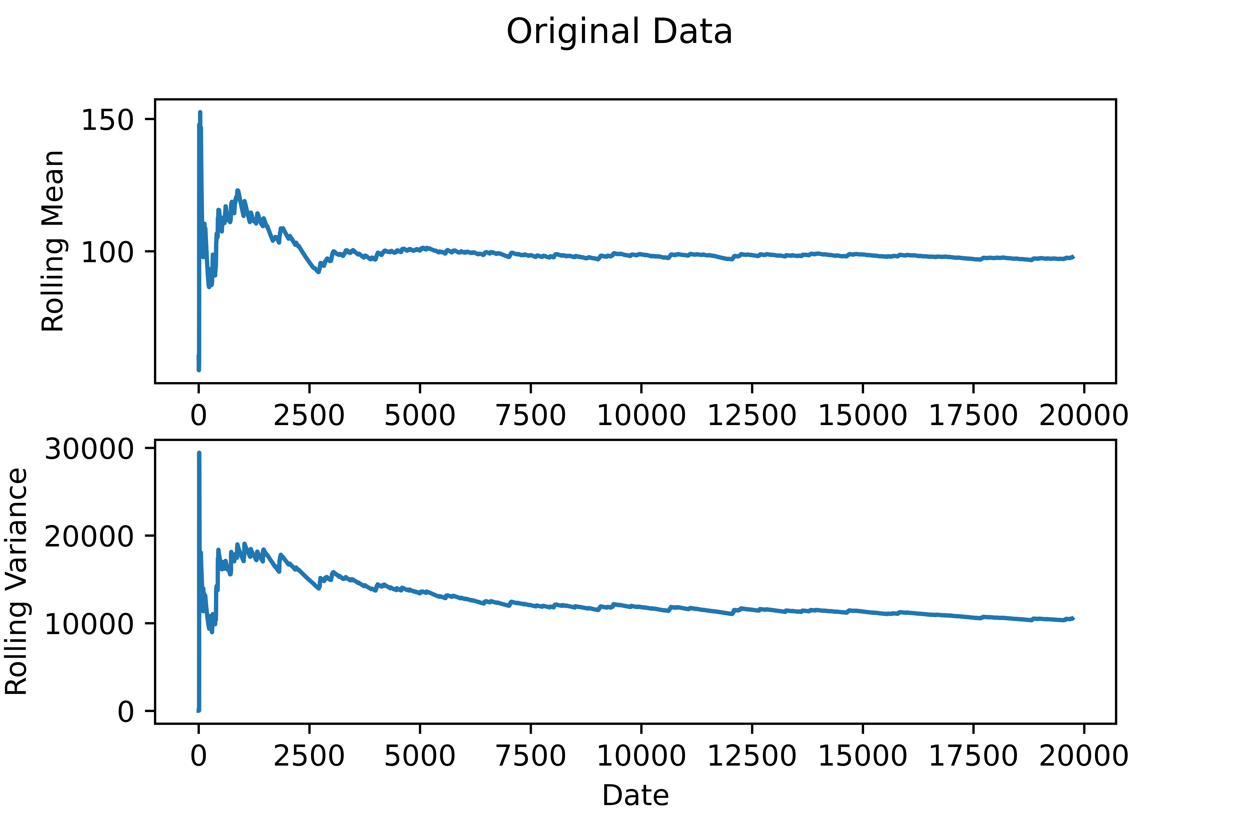
Some of the variable names didn’t make it into the heat plots labels because there are so many.
Clearly we see the classic check marked scheme in the correlation matrix, indicating lower levels of collinearity.
Rolling mean/variance of the original dependent variable shows stationarity in the values but not necessarily stationarity in the variance, but pretty close.

Slide 7
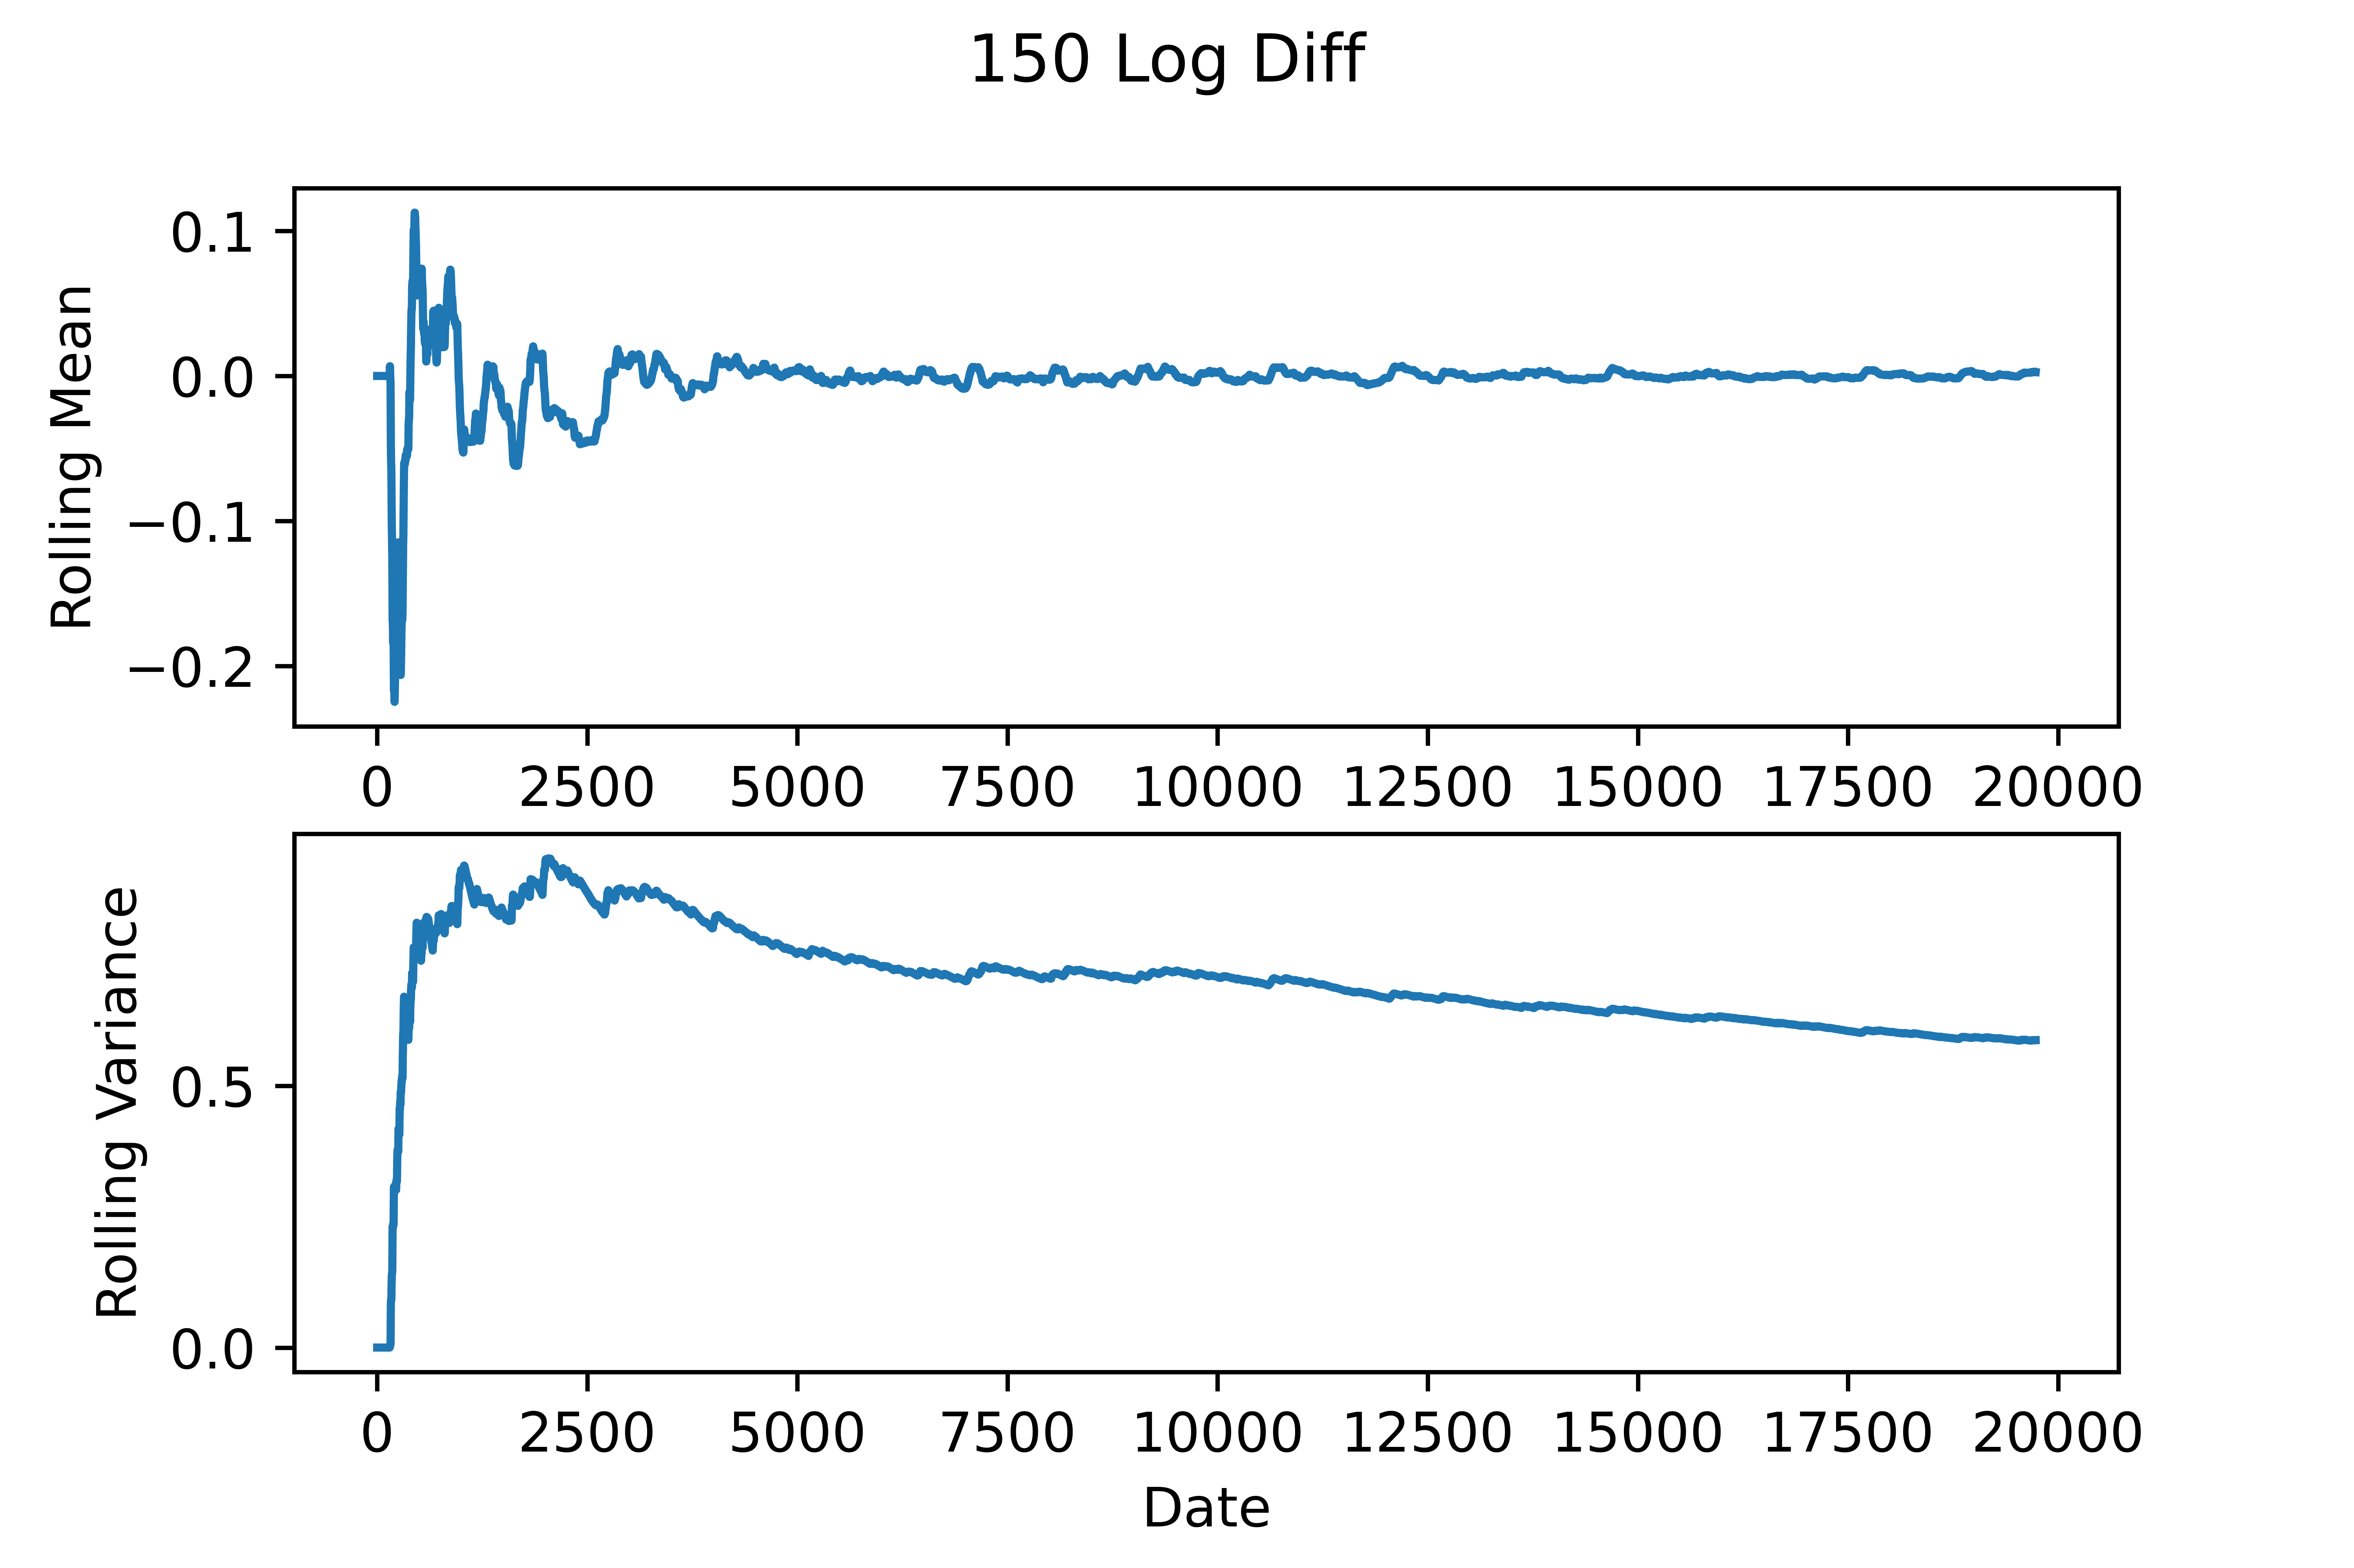
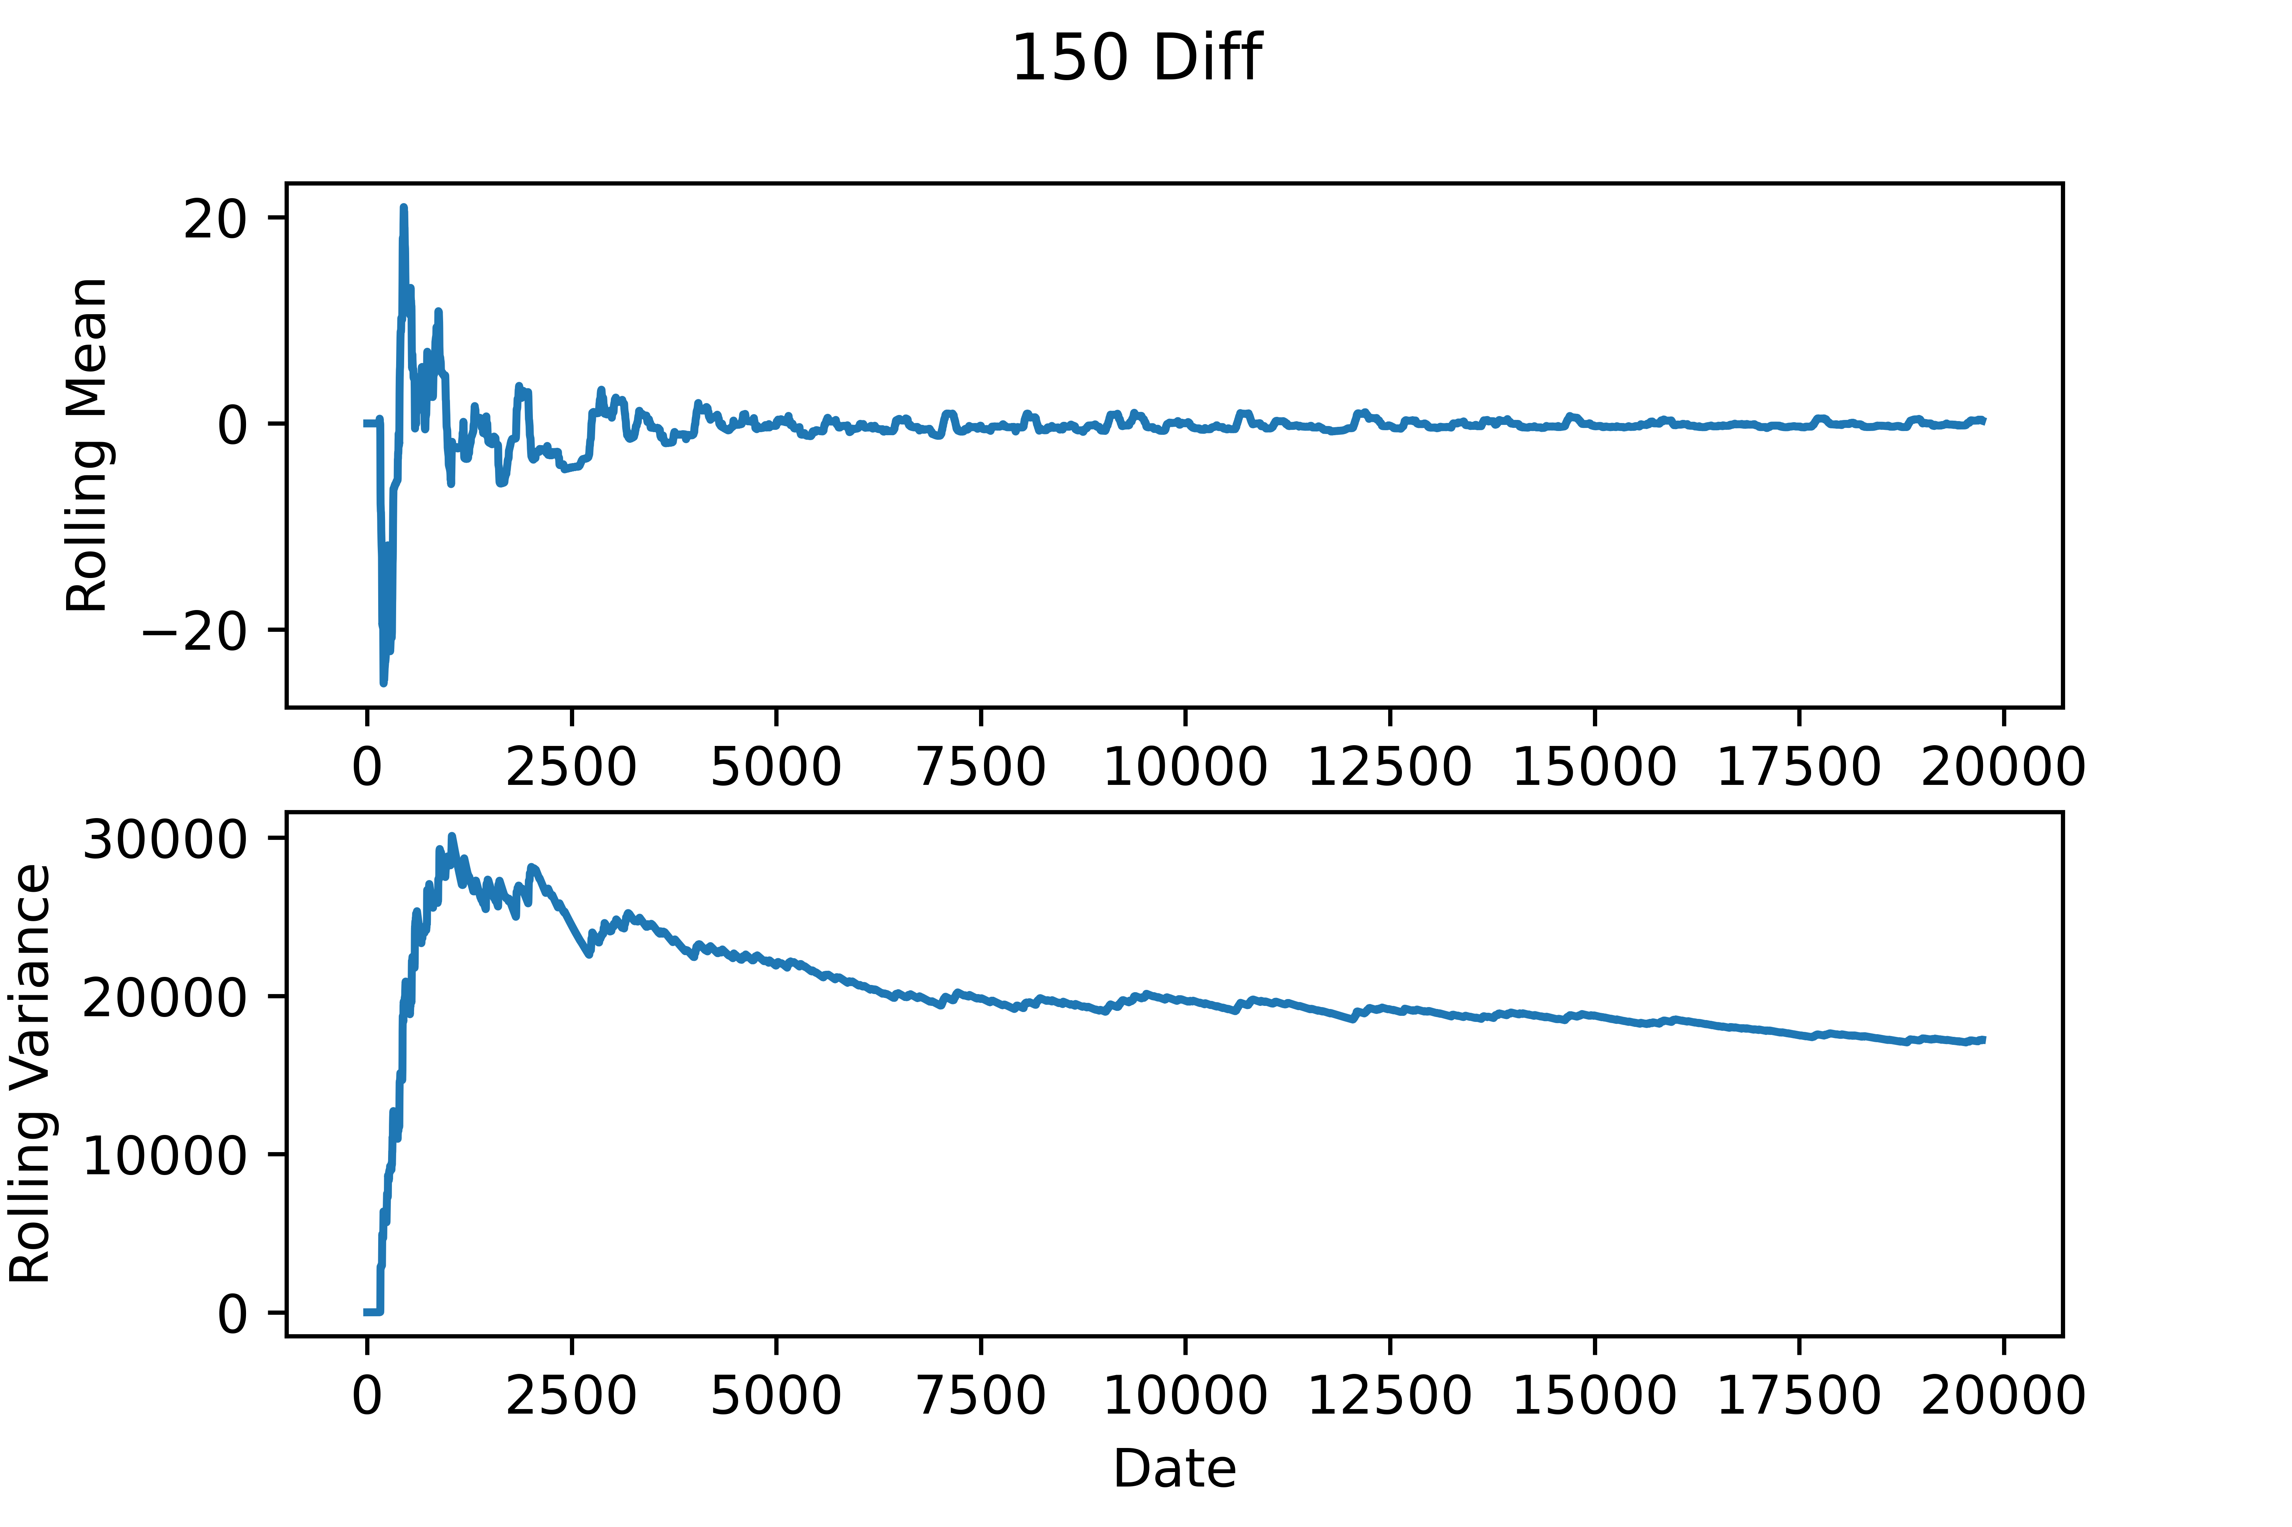
Differencing and Log-Diff
I chose 150 as a differencing interval as it is near a full day (which is actually 144 steps as the data moves at 10 minute intervals)
Differencing at that interval does make the rolling mean even more stationary but doesn’t help with making the variance stationary
Taking the log-diff at that interval makes the variance of the mean even worse
I decided to stick with undifferenced data
Both the ADF and KPSS tests indicated stationarity.
ADF test statistic for original was -21, KPSS was 0.03, both indicate stationarity.

Slide 8
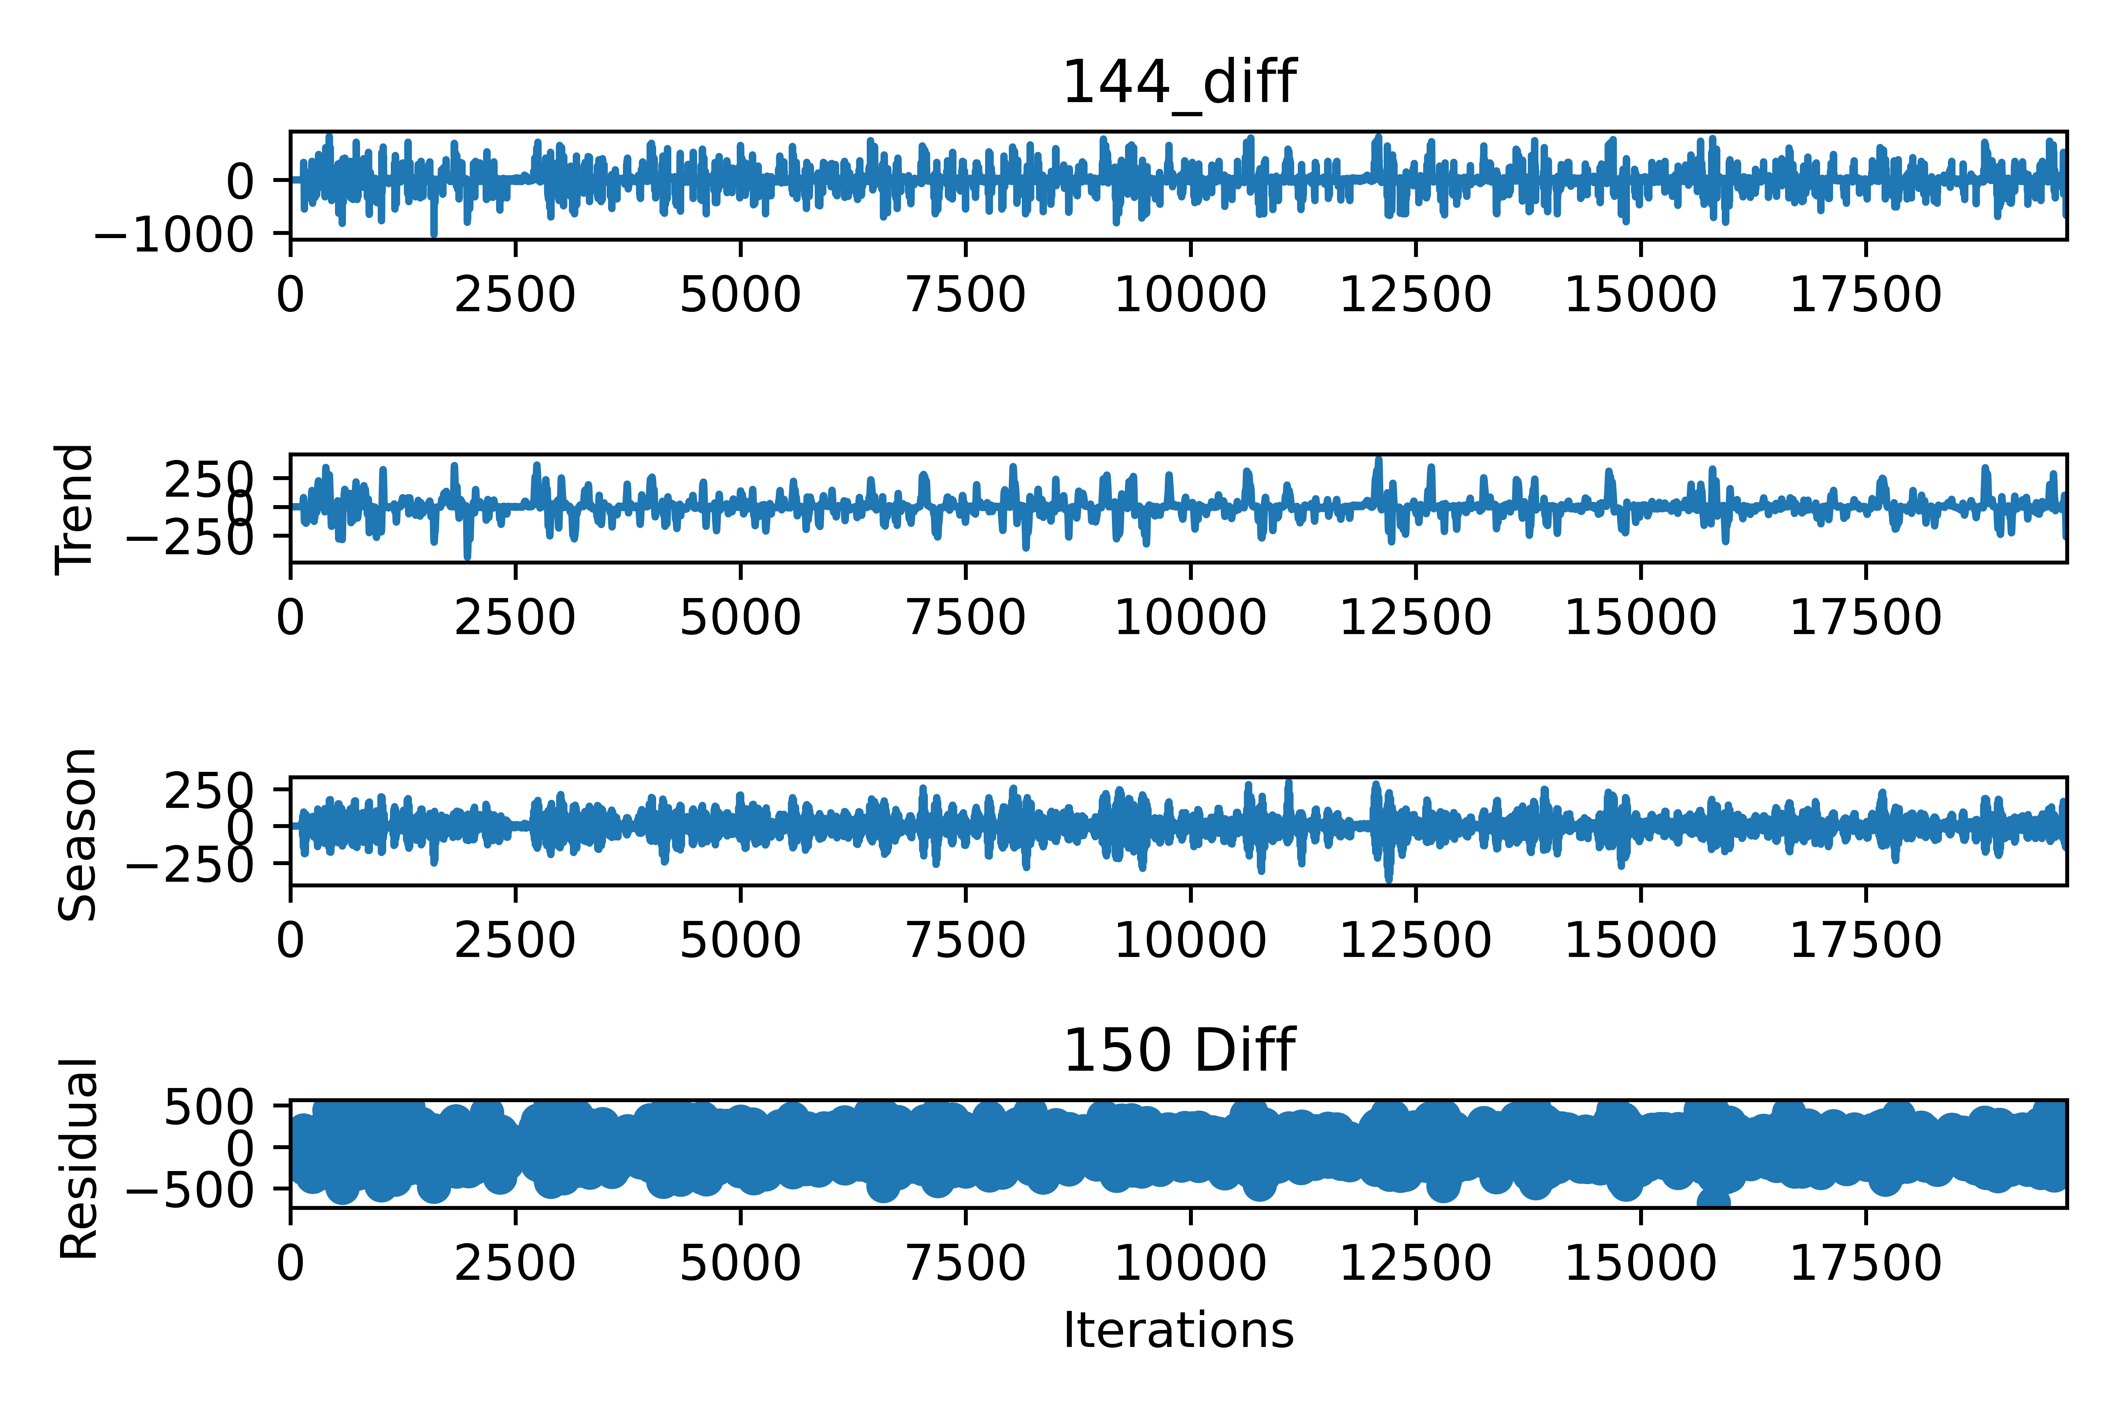
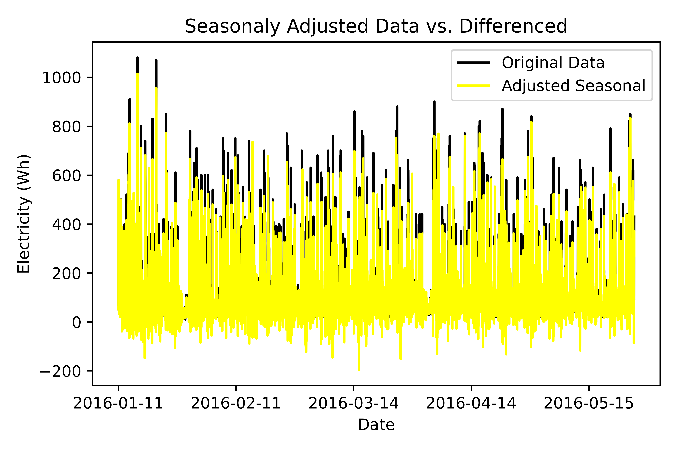
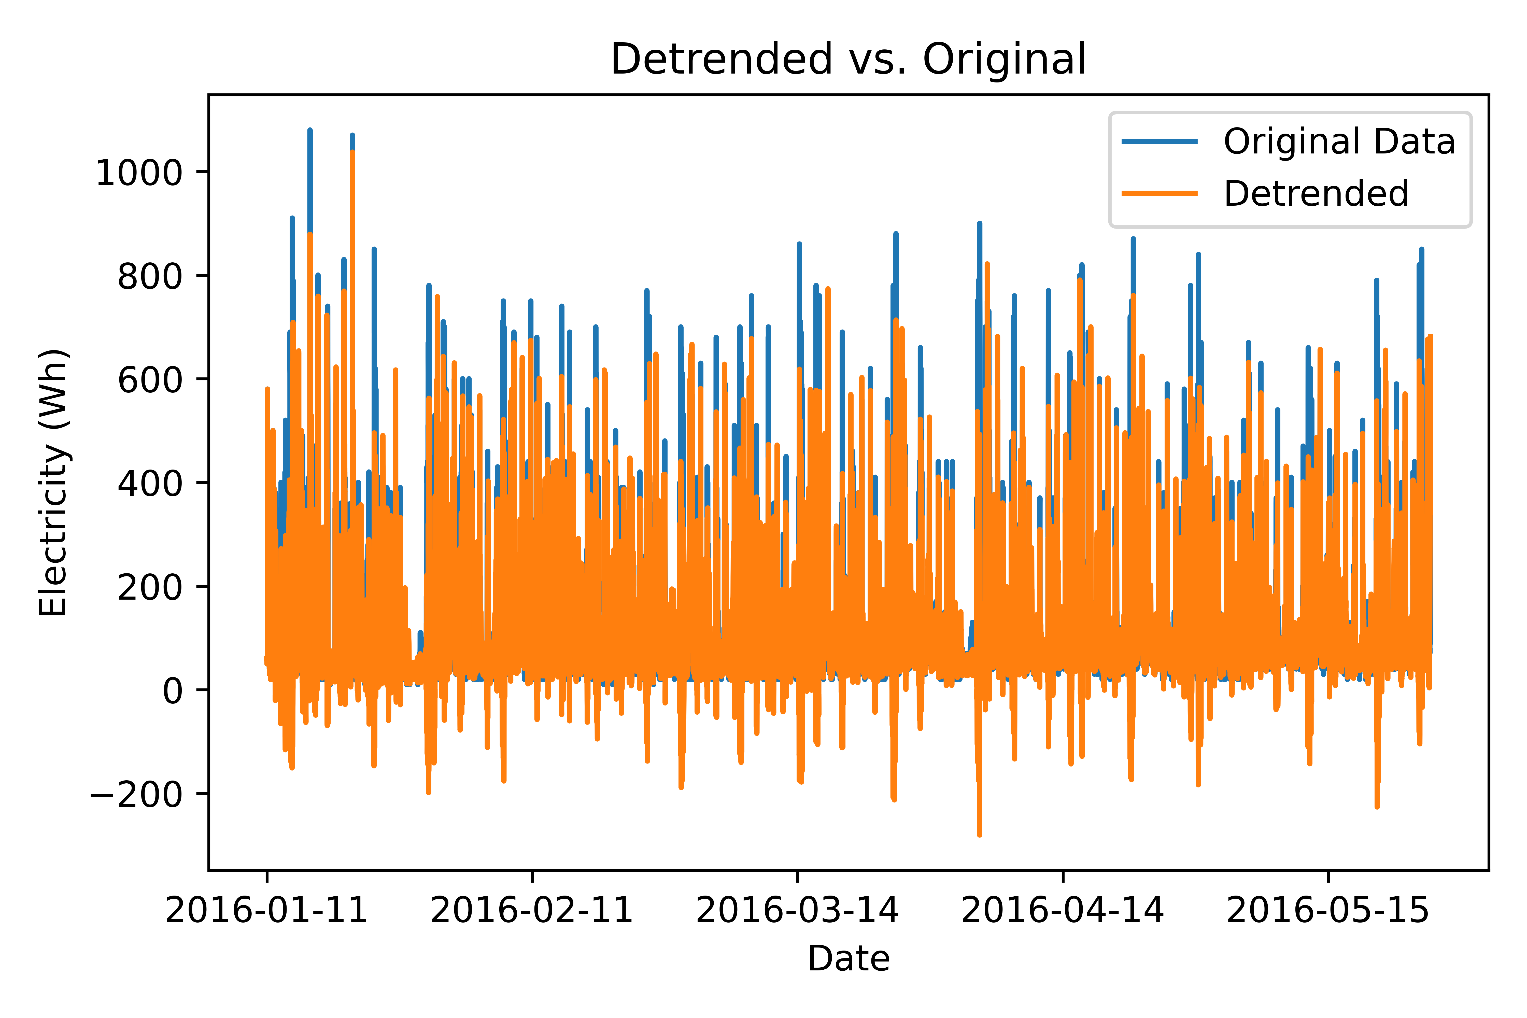
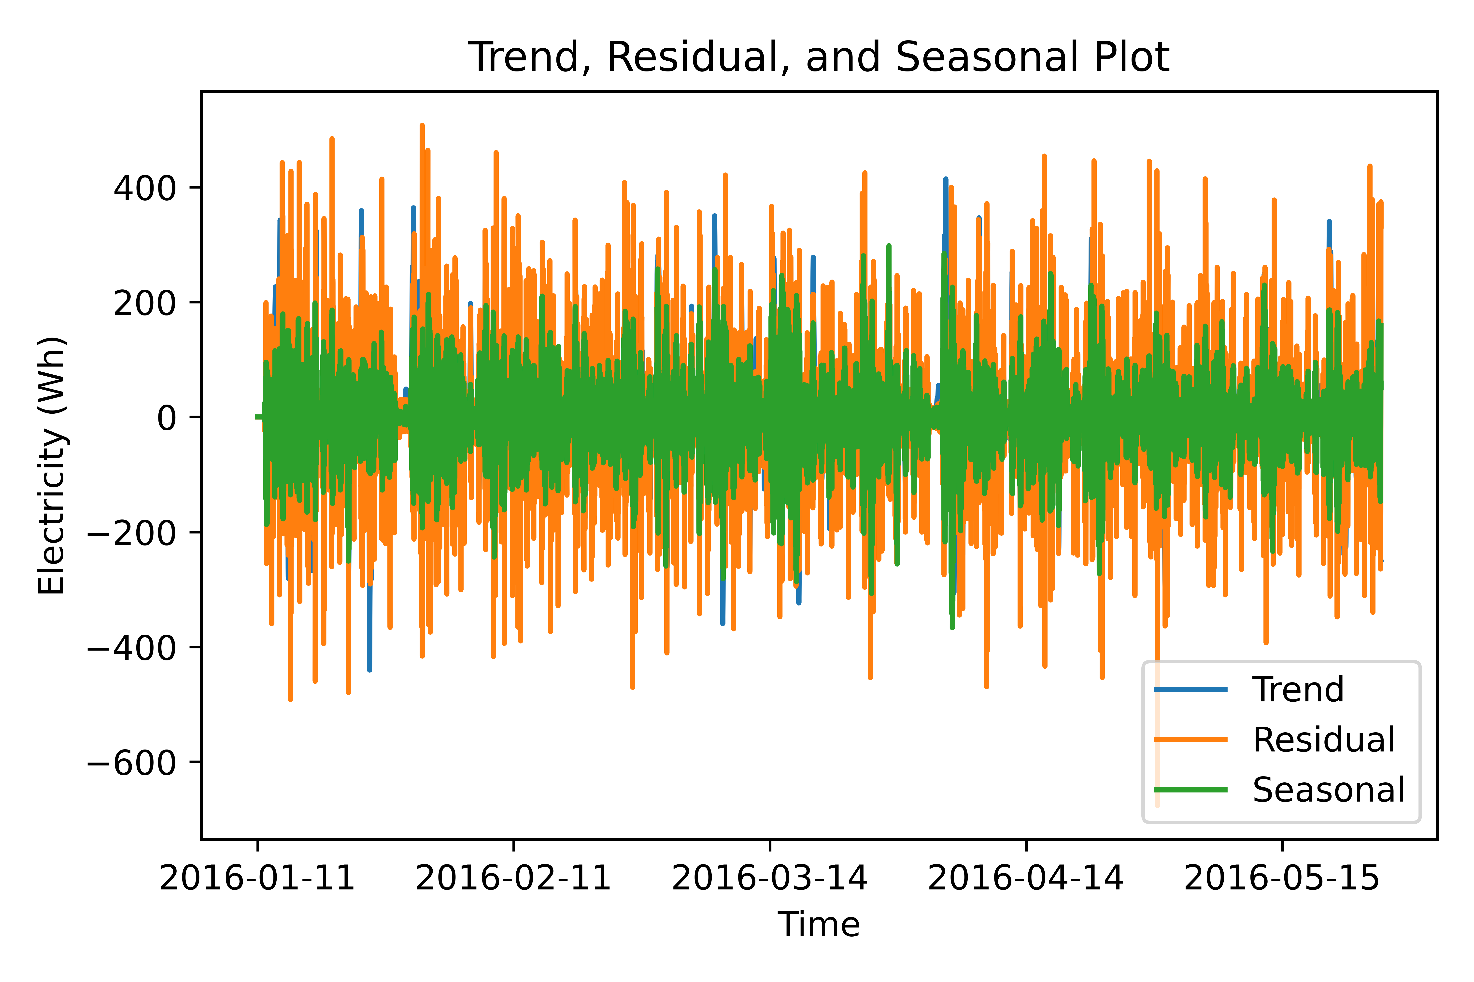
Decomposition Analysis
Strength of Trend = 0.6
Strength of Seasonality = 0.3

Slide 9
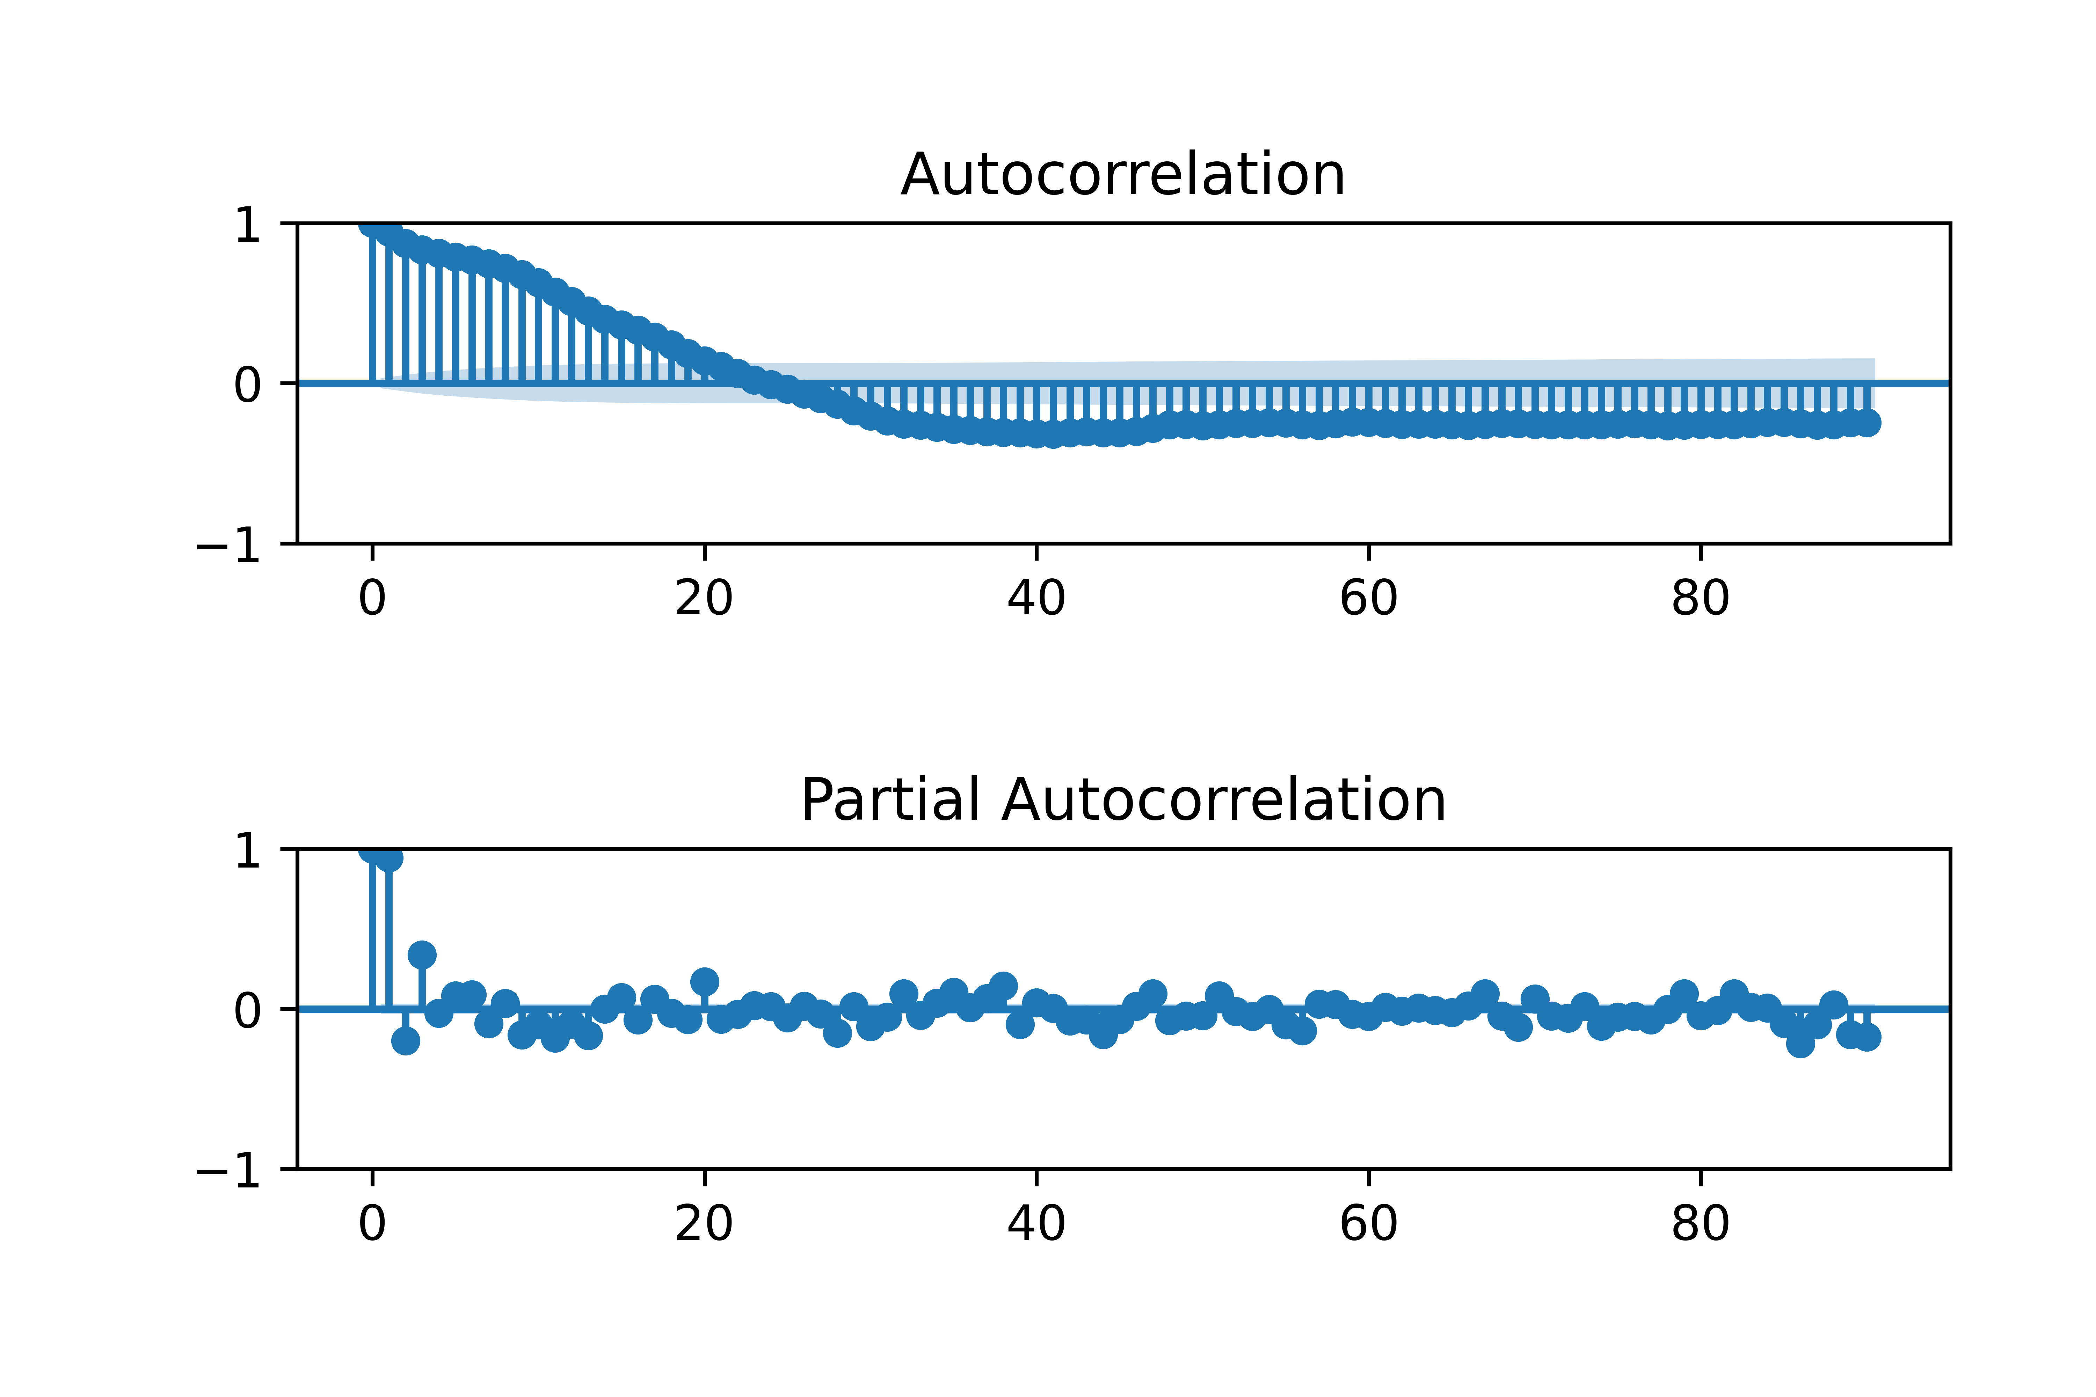
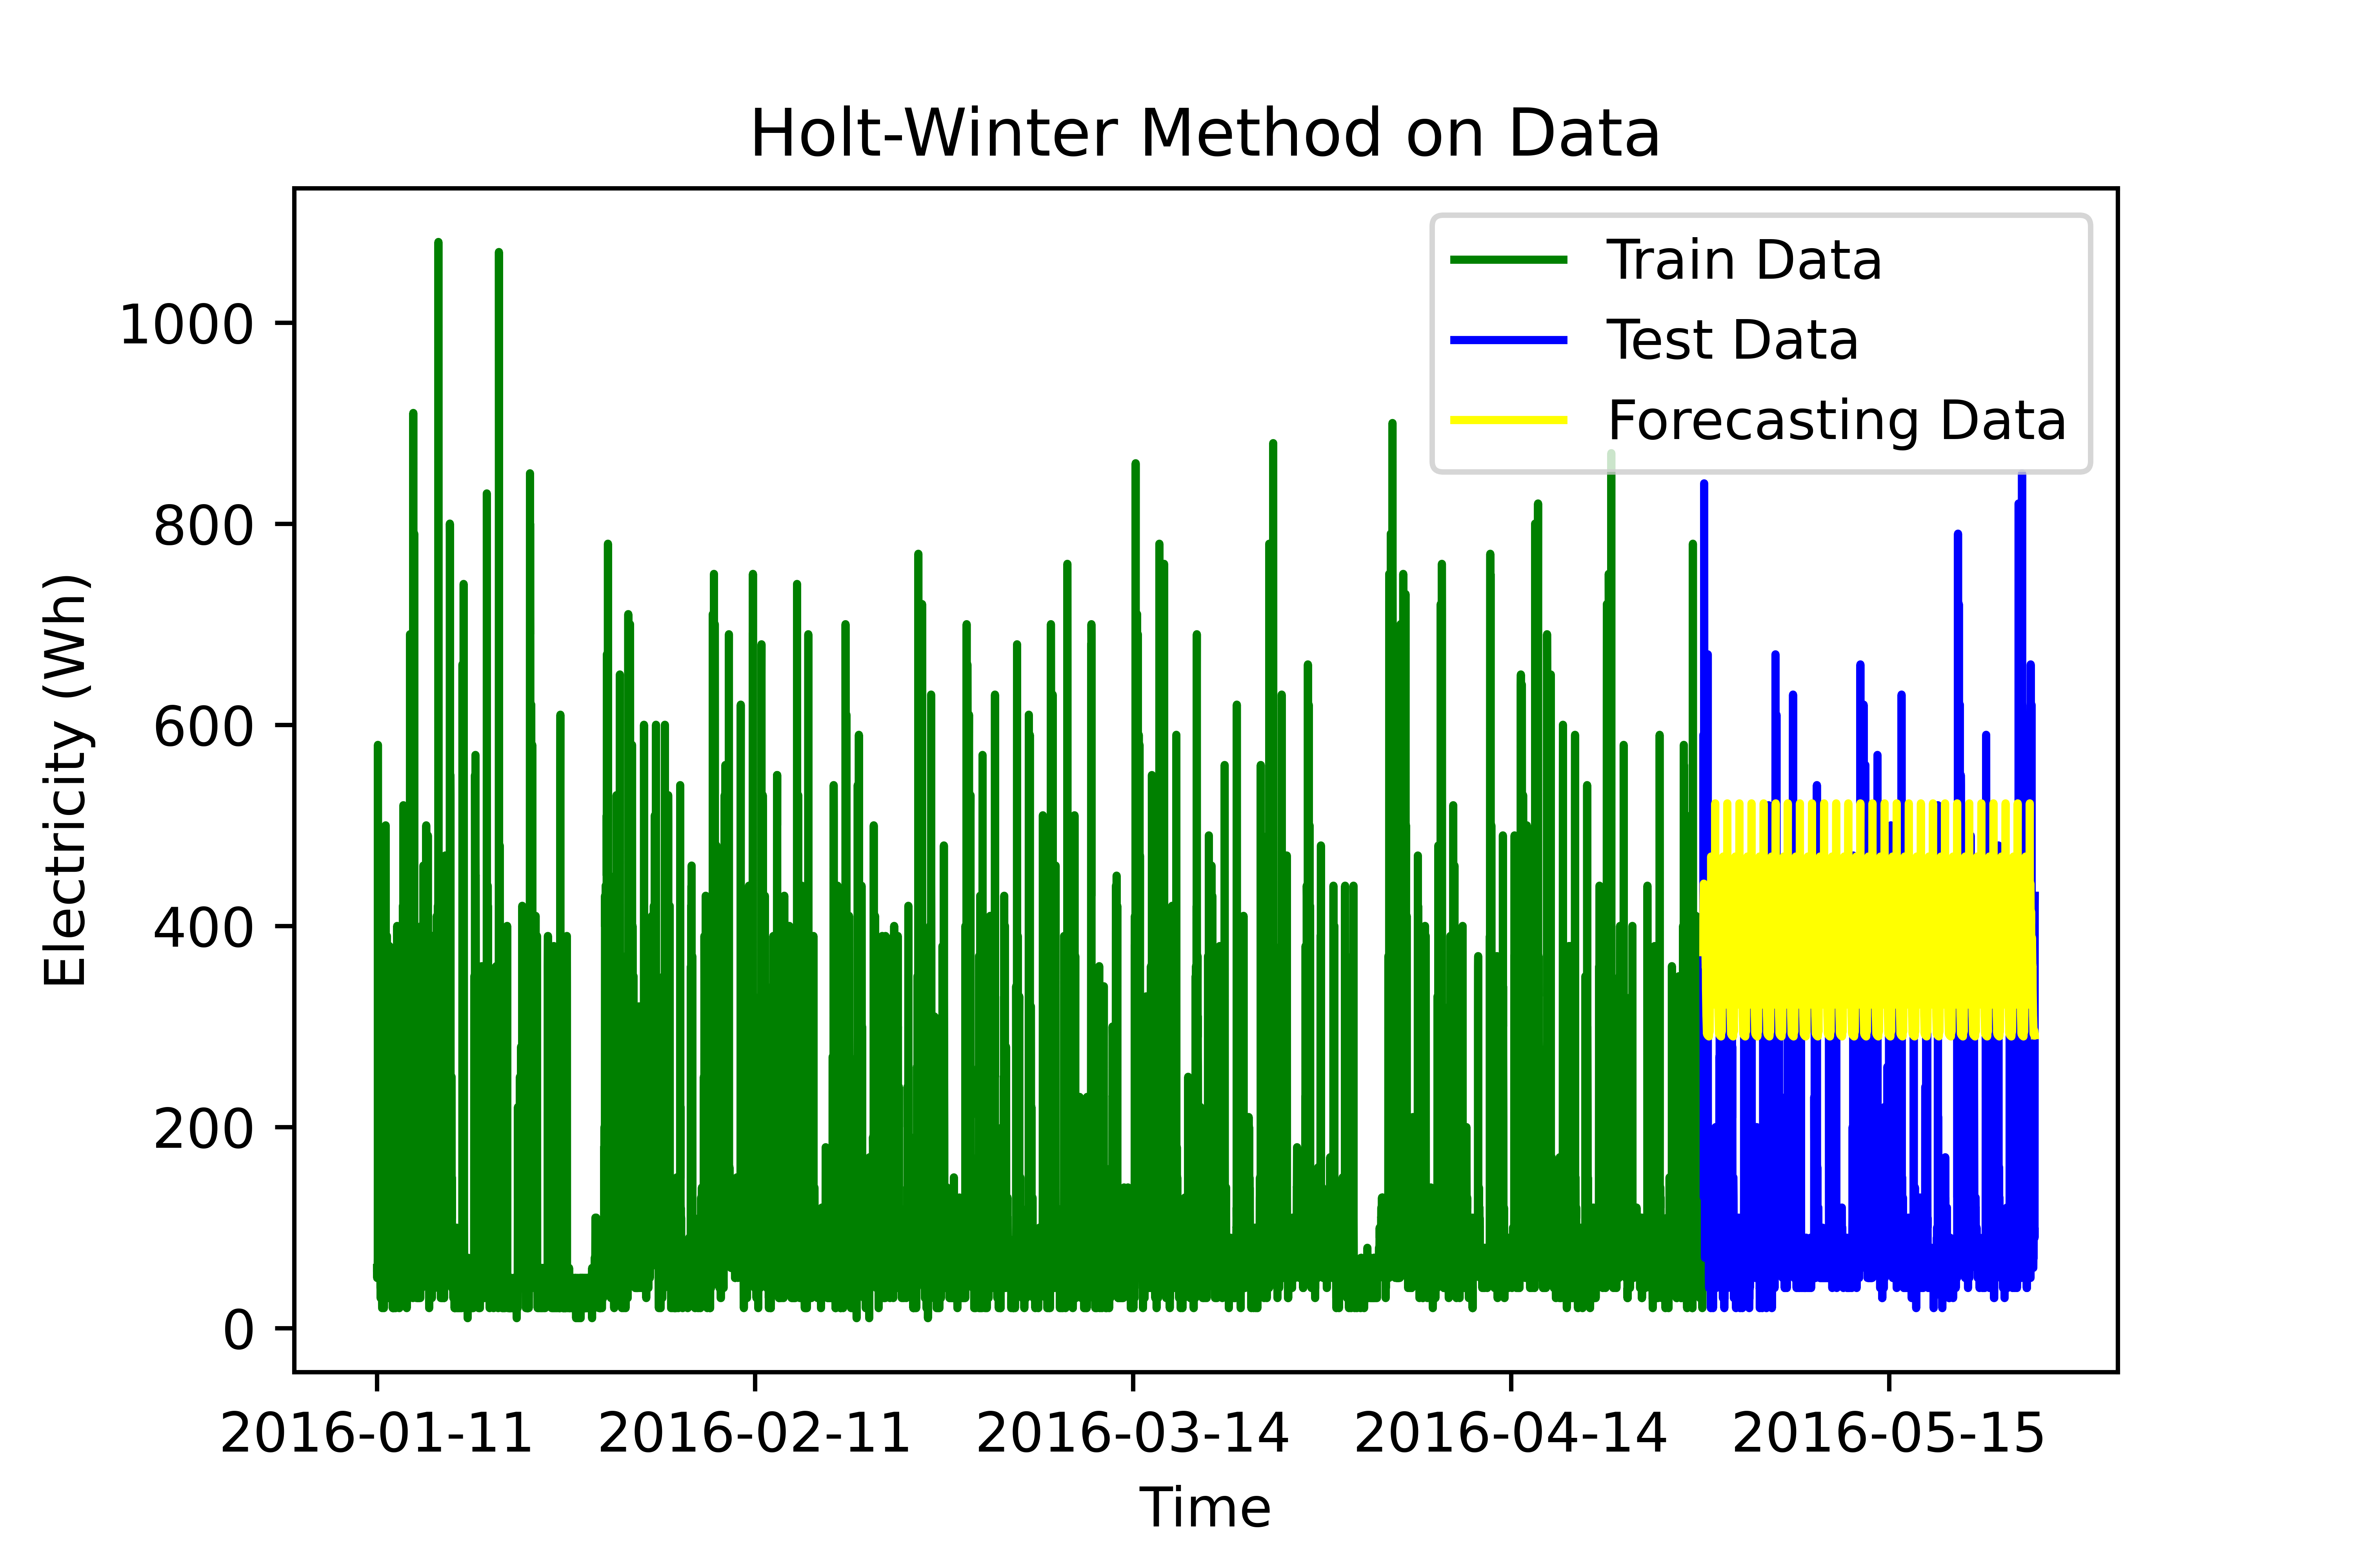
Holt-Winters Model
MSE = 80324
Q = 17055
Error Var = 10564

Slide 10
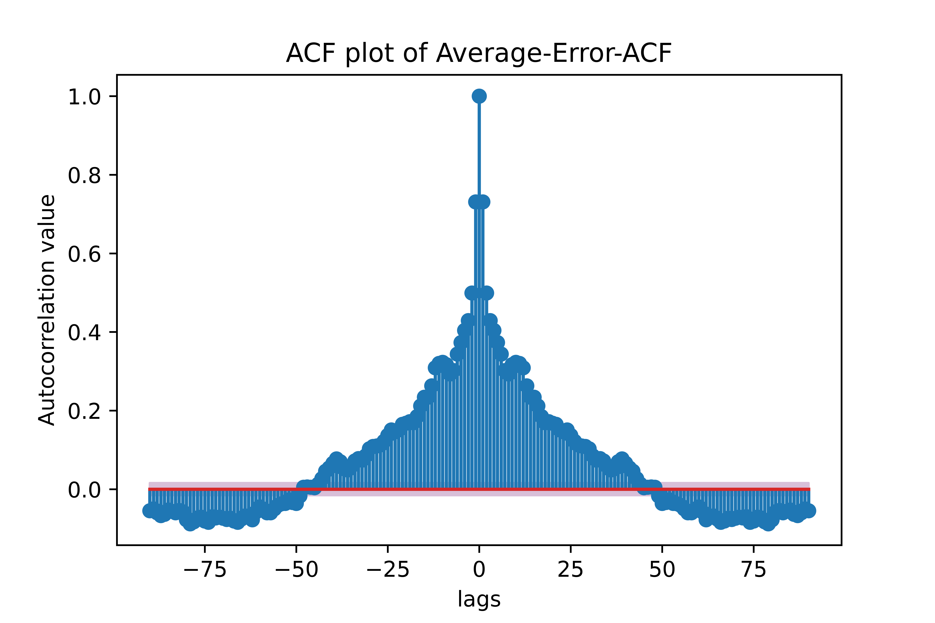
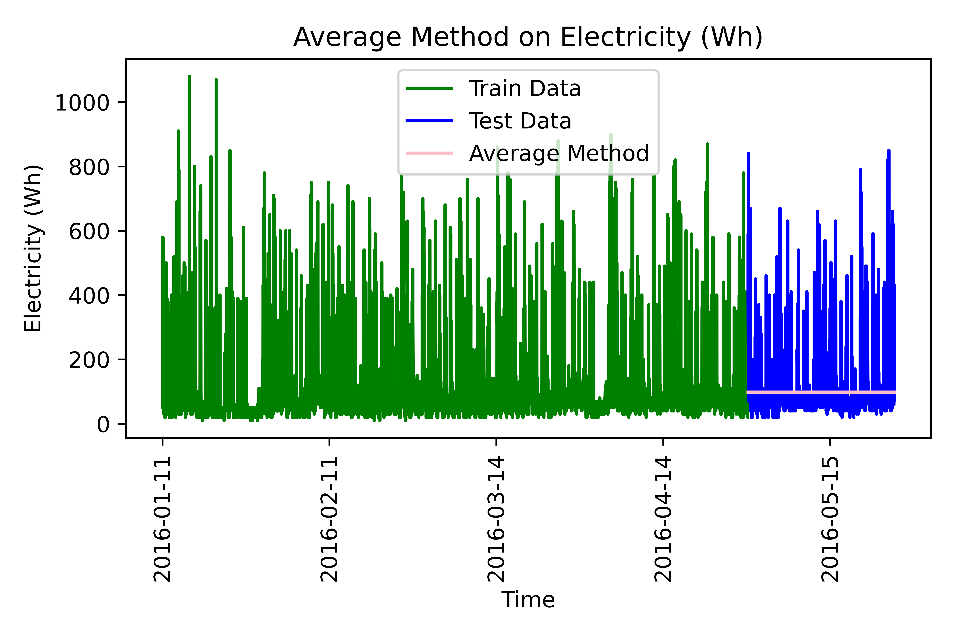
Average Method
MSE = 11074
Q value = 21037
Error Var = 5381

Slide 11
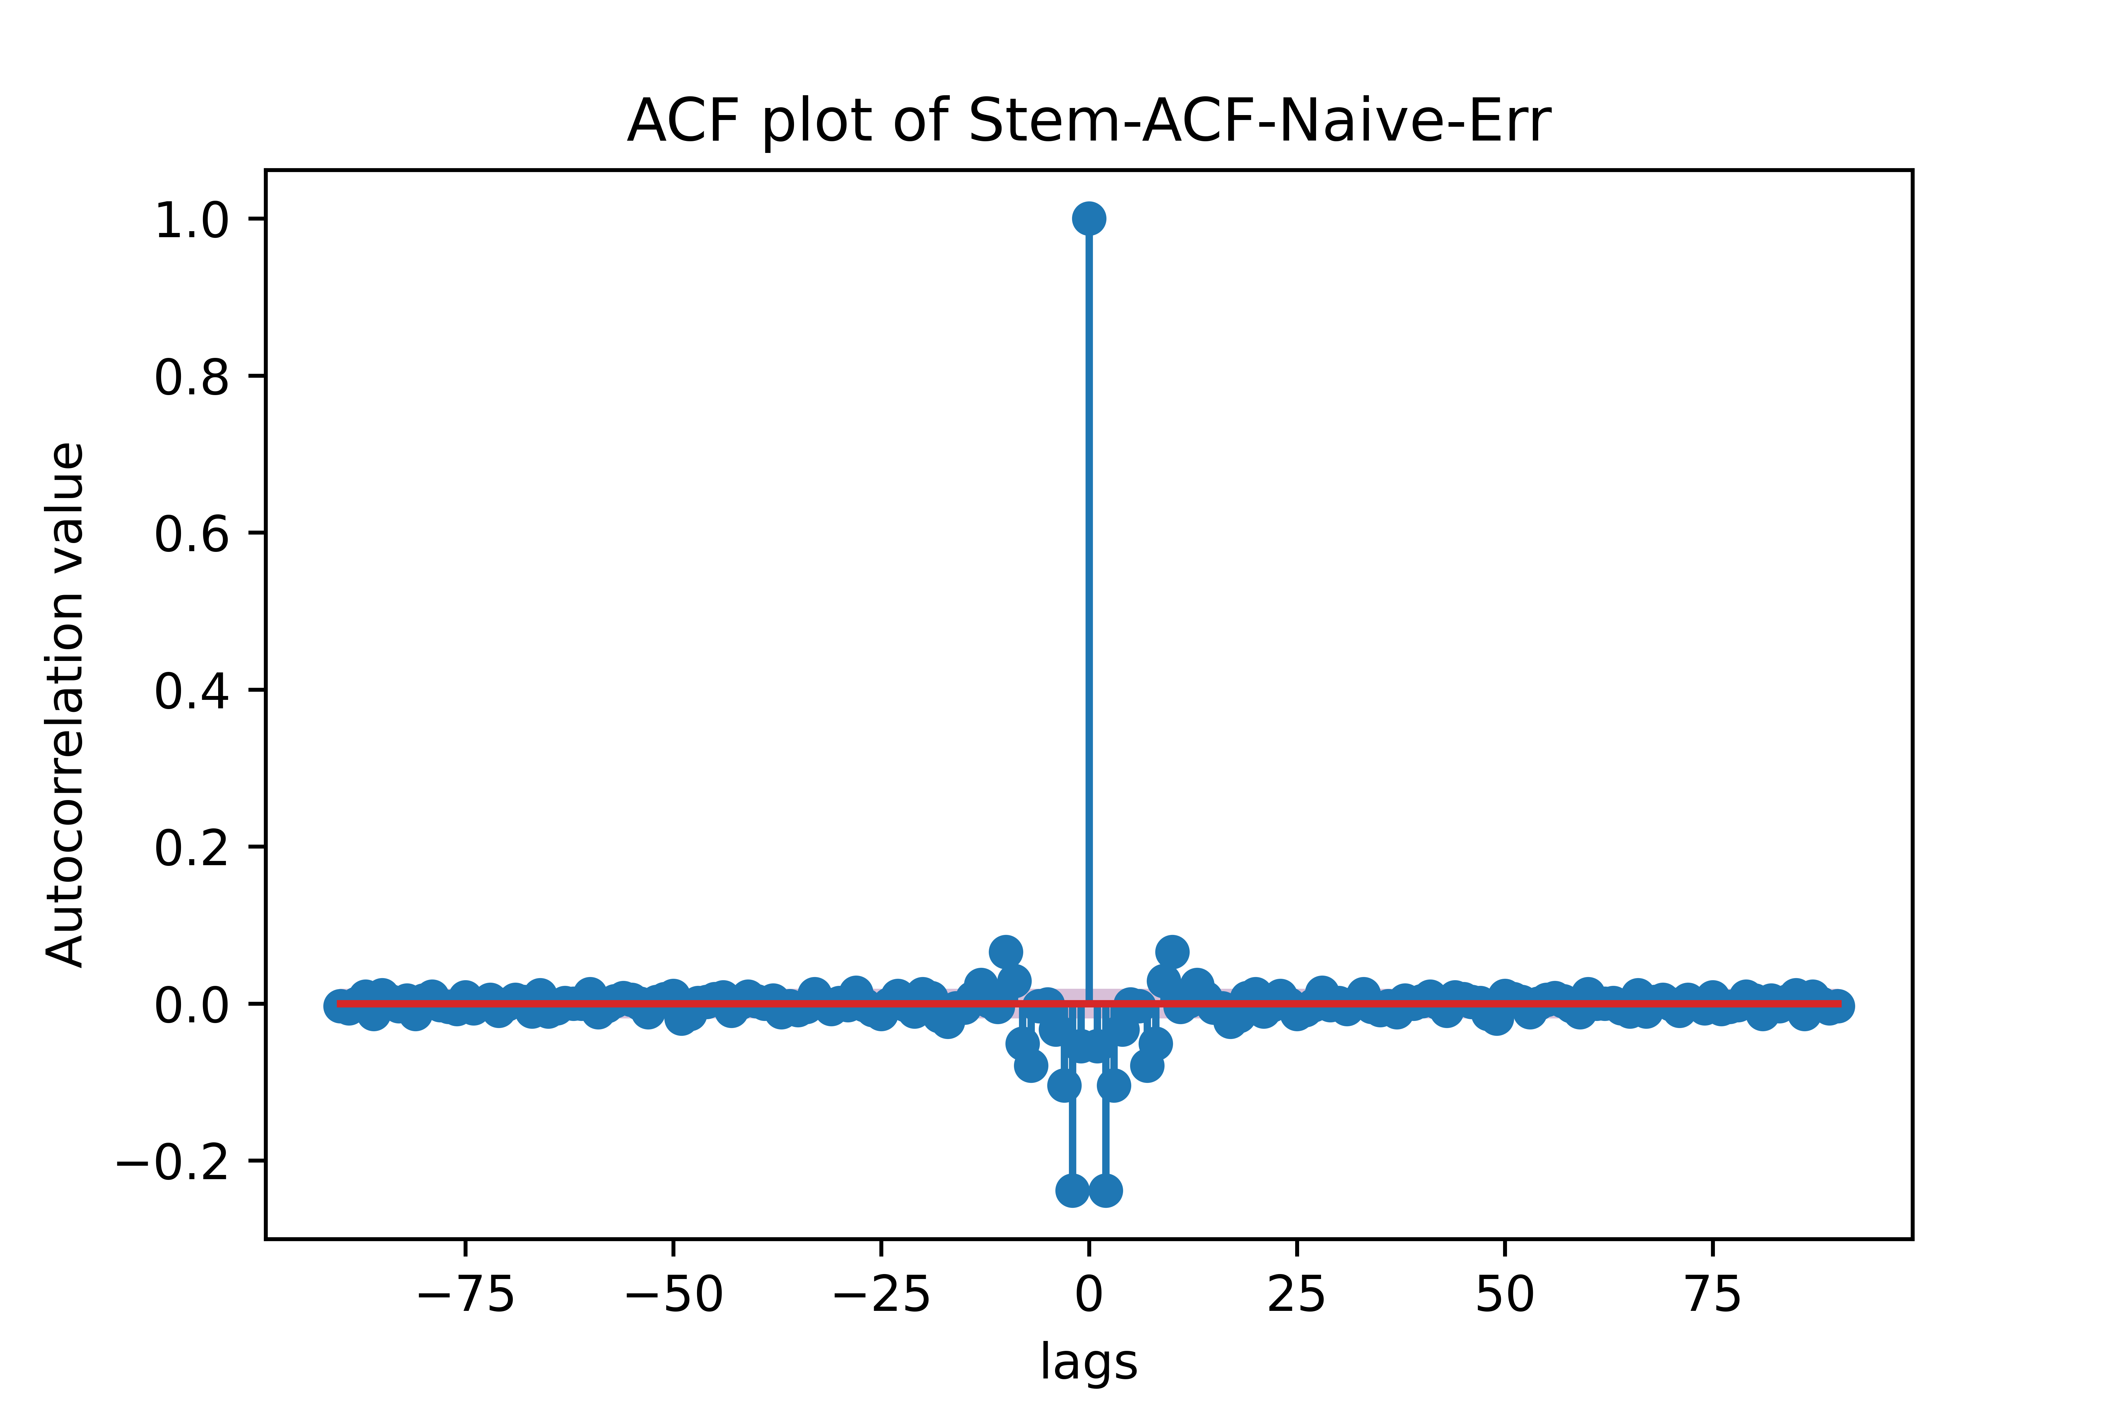
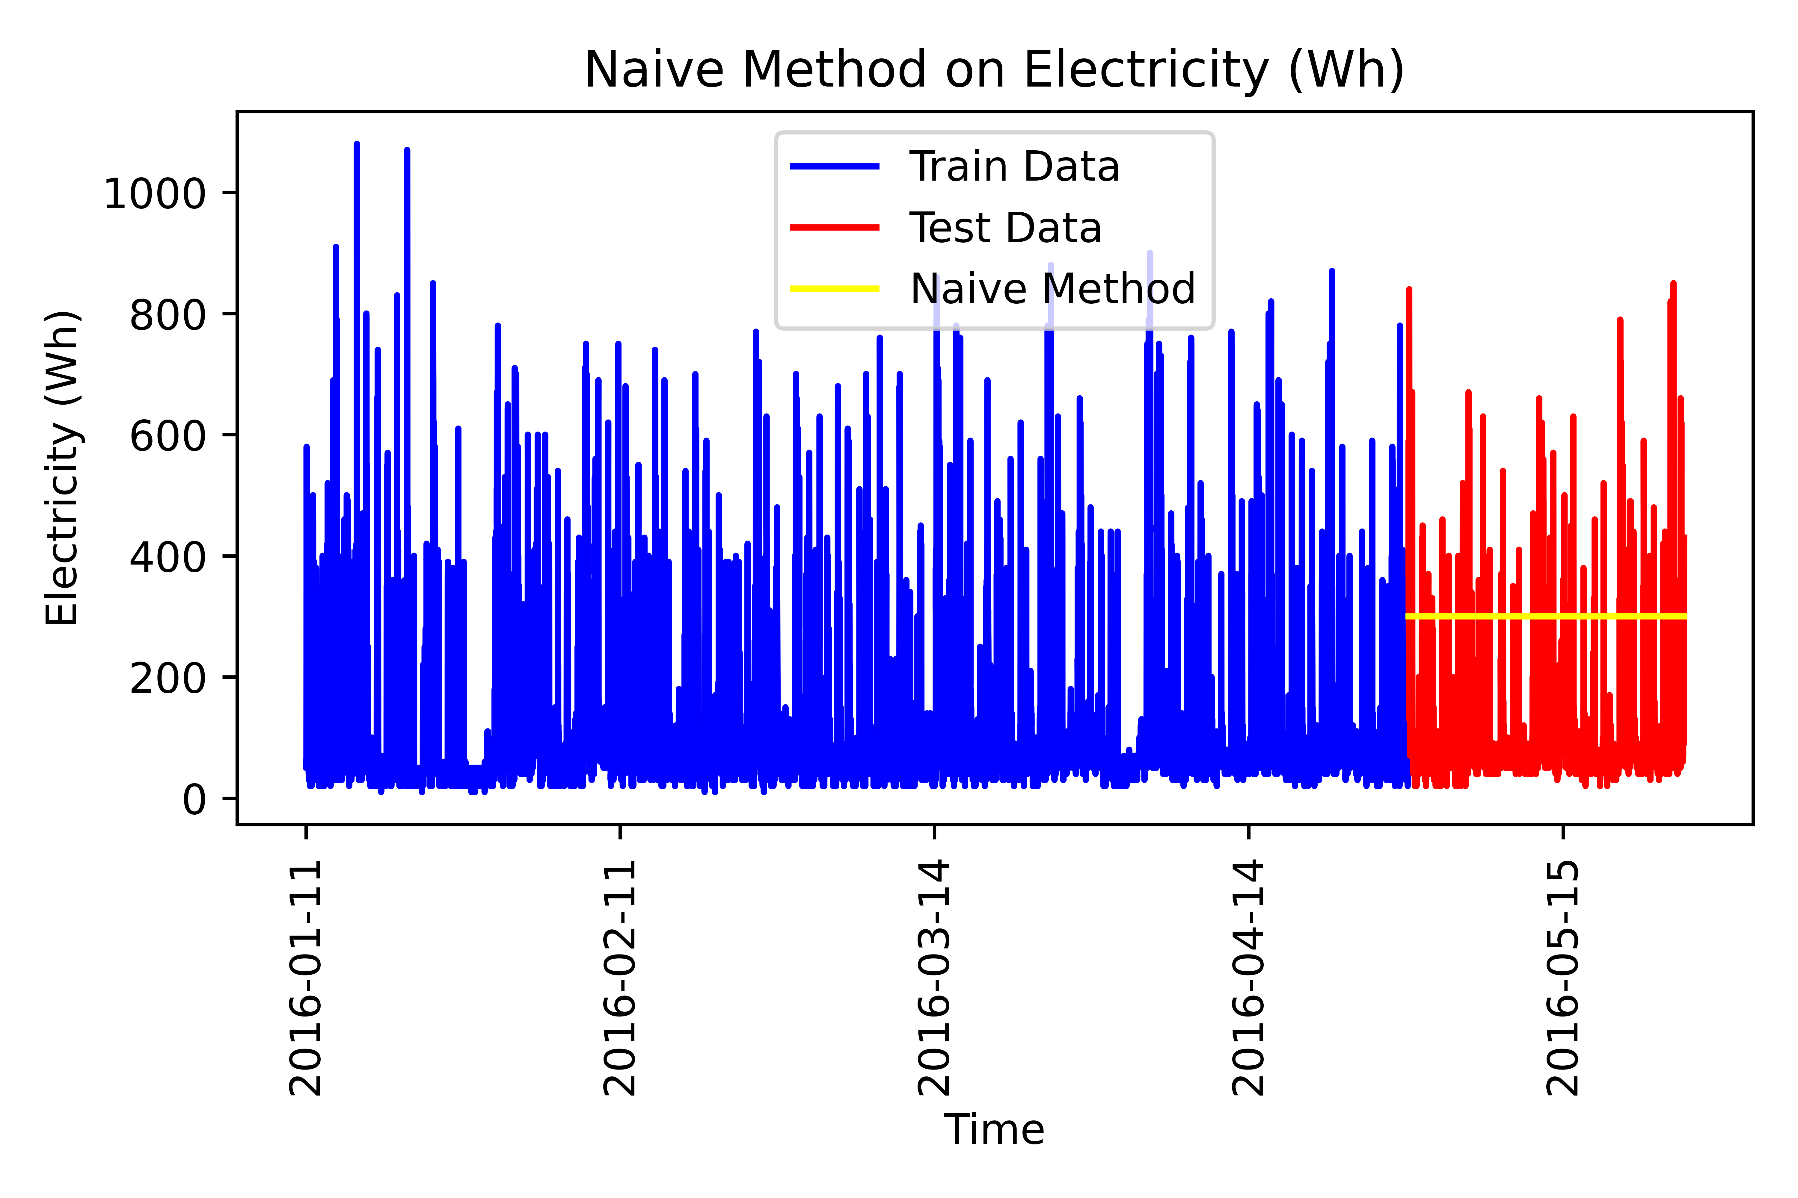
Naïve Method
MSE = 5381
Q – Value = 1129

Slide 12

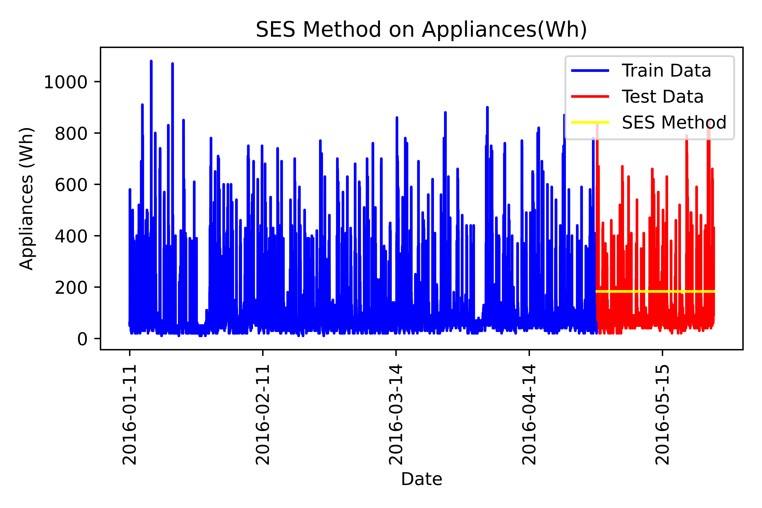
SES Method
MSE = 5717
Q Value = 2705

Slide 13
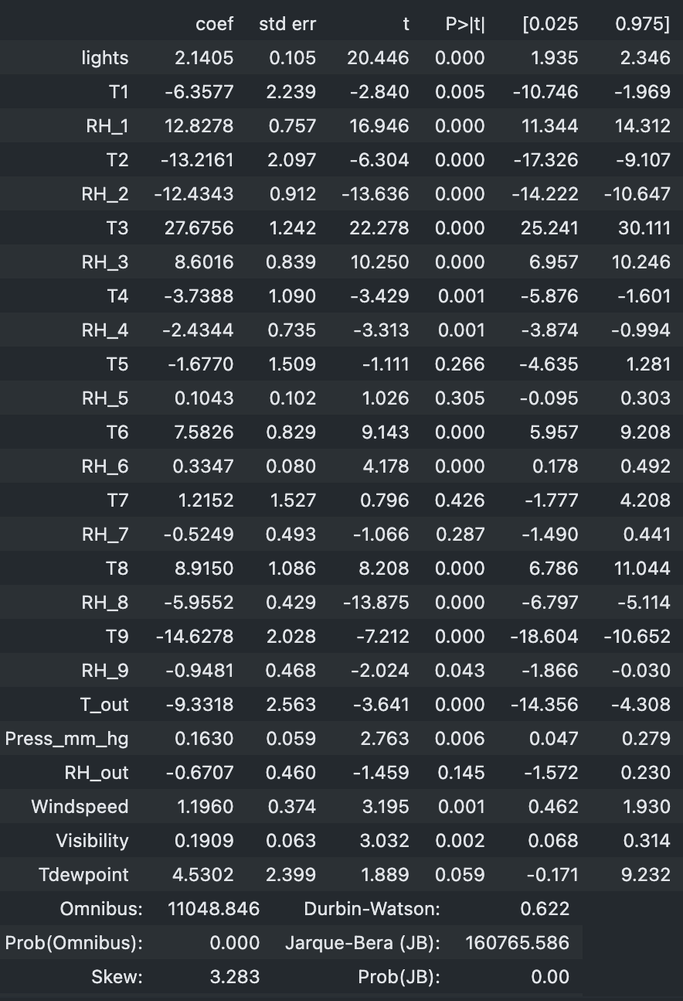
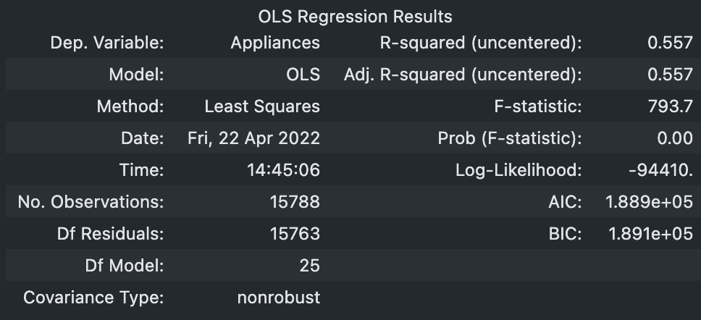
Linear Regression with all variables

Slide 14
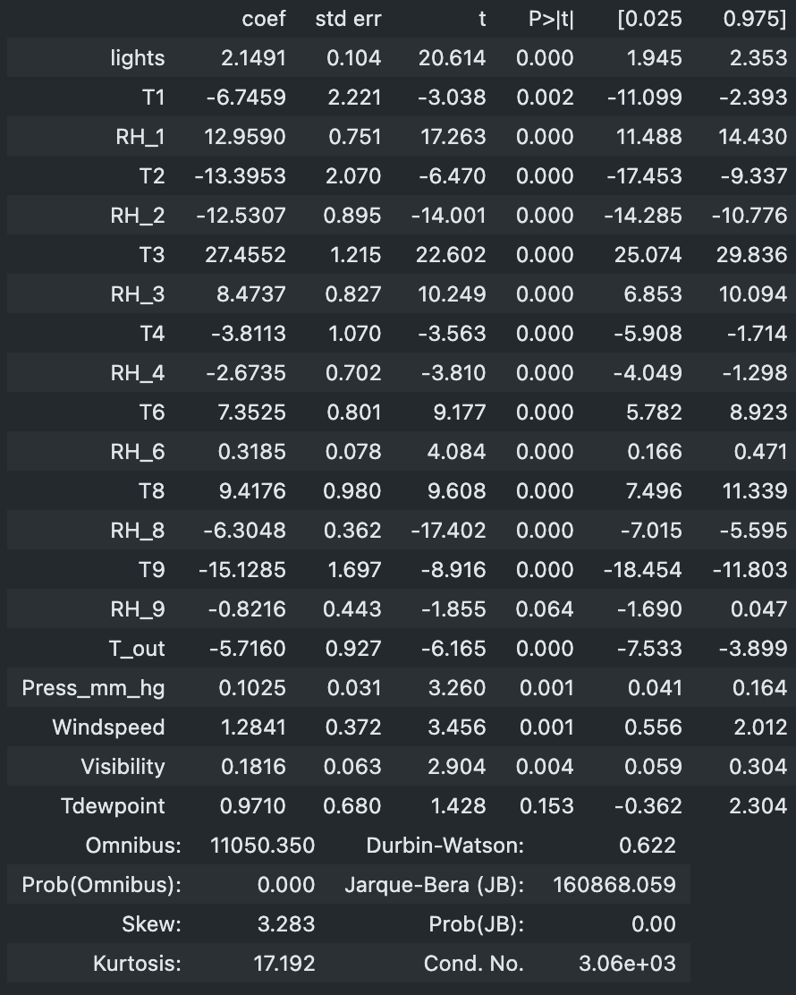
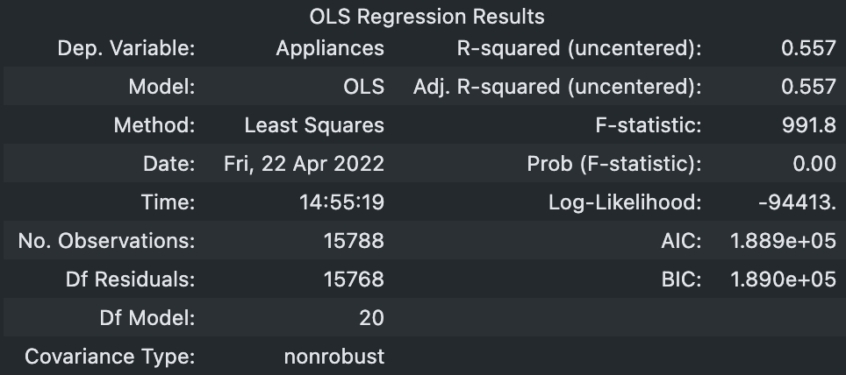
After ['T5','RH_5','T7','RH_7','RH_out’] are removed from the model
Very little change using backwards selection. F-statistic increased somewhat.

Slide 15
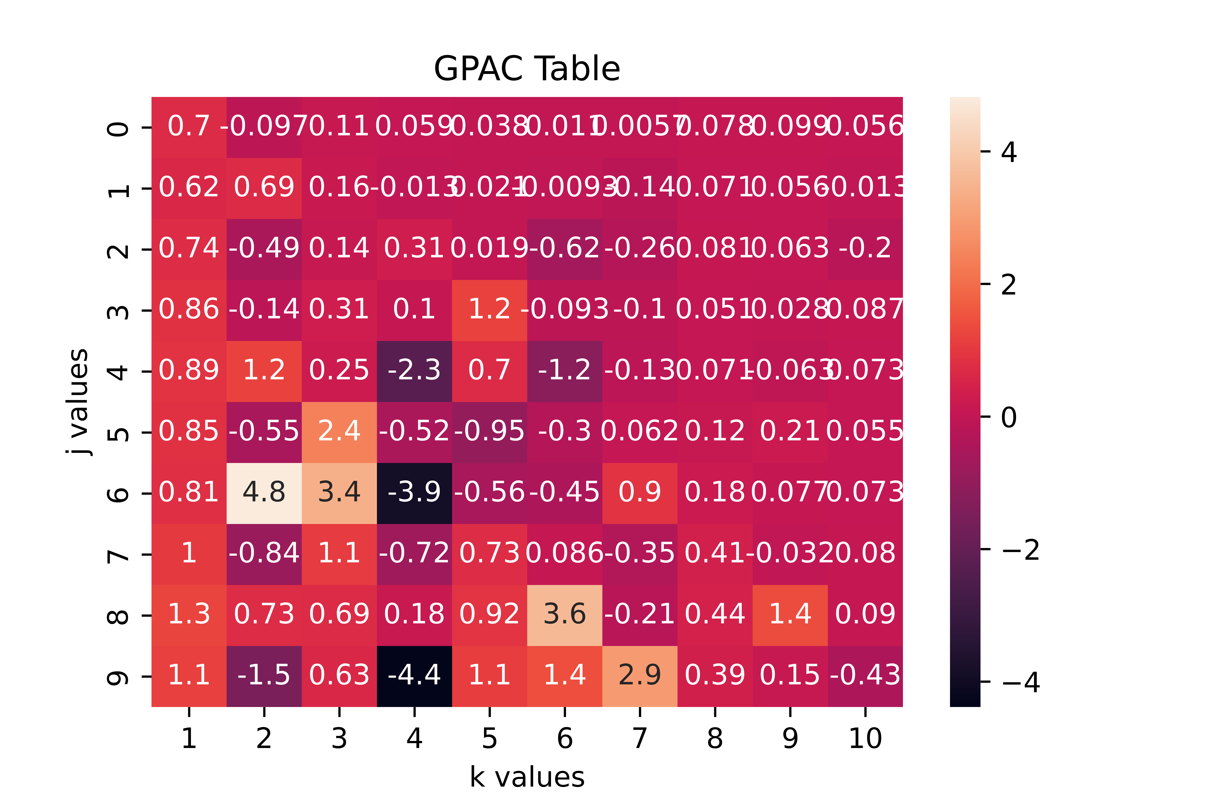
The GPAC is a bit difficult to interpret, but a third degree AR model is my guess for the order of the ARMA model

Slide 16
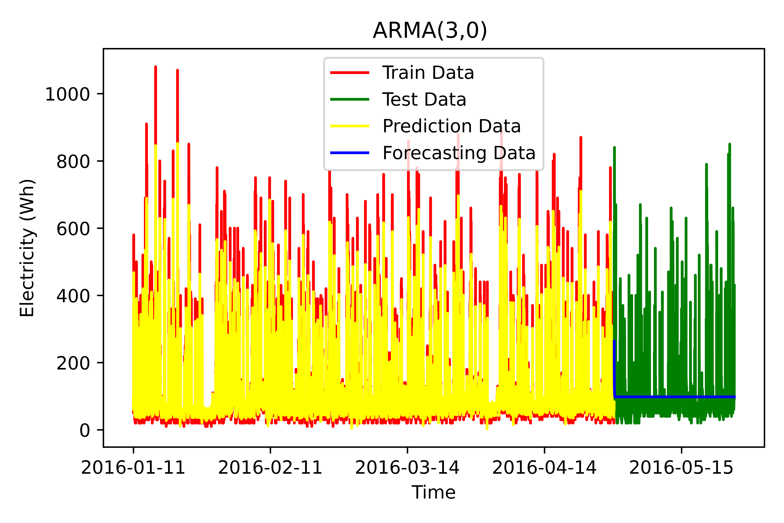
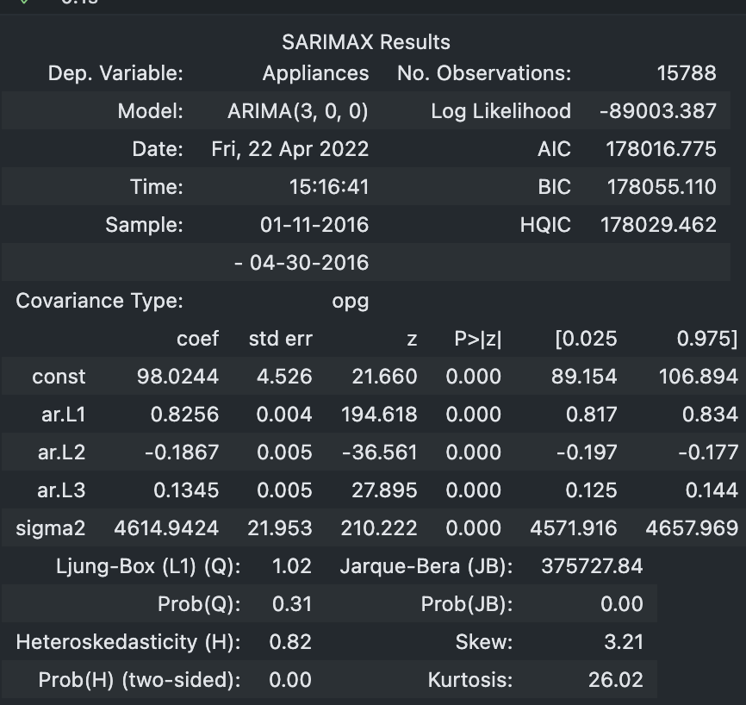
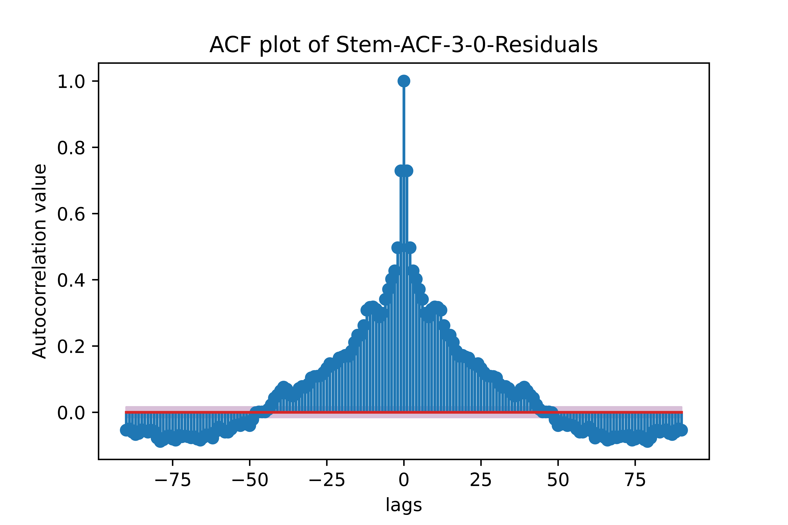
ARMA (3,0) had a MSE of 8206

Slide 17

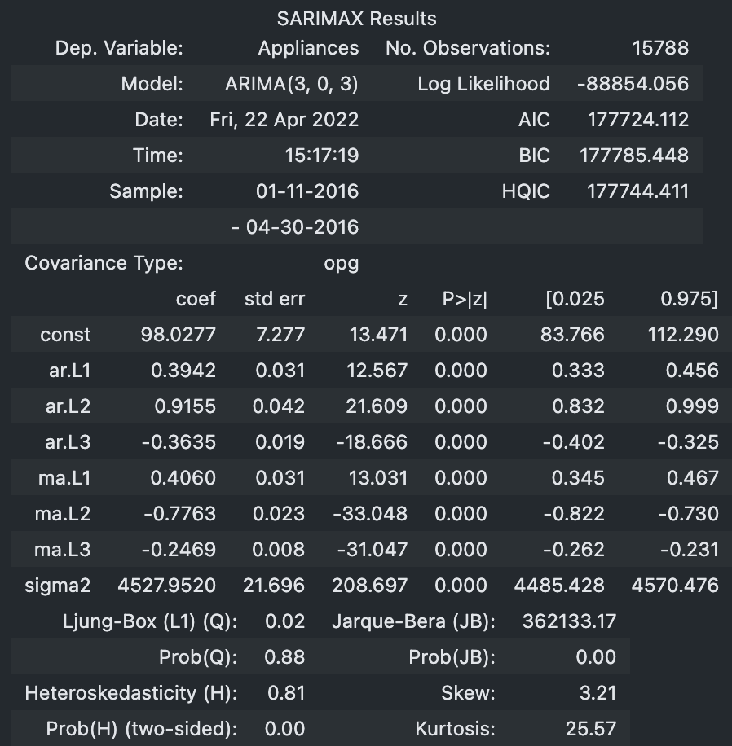

ARMA (3,3)

Slide 18
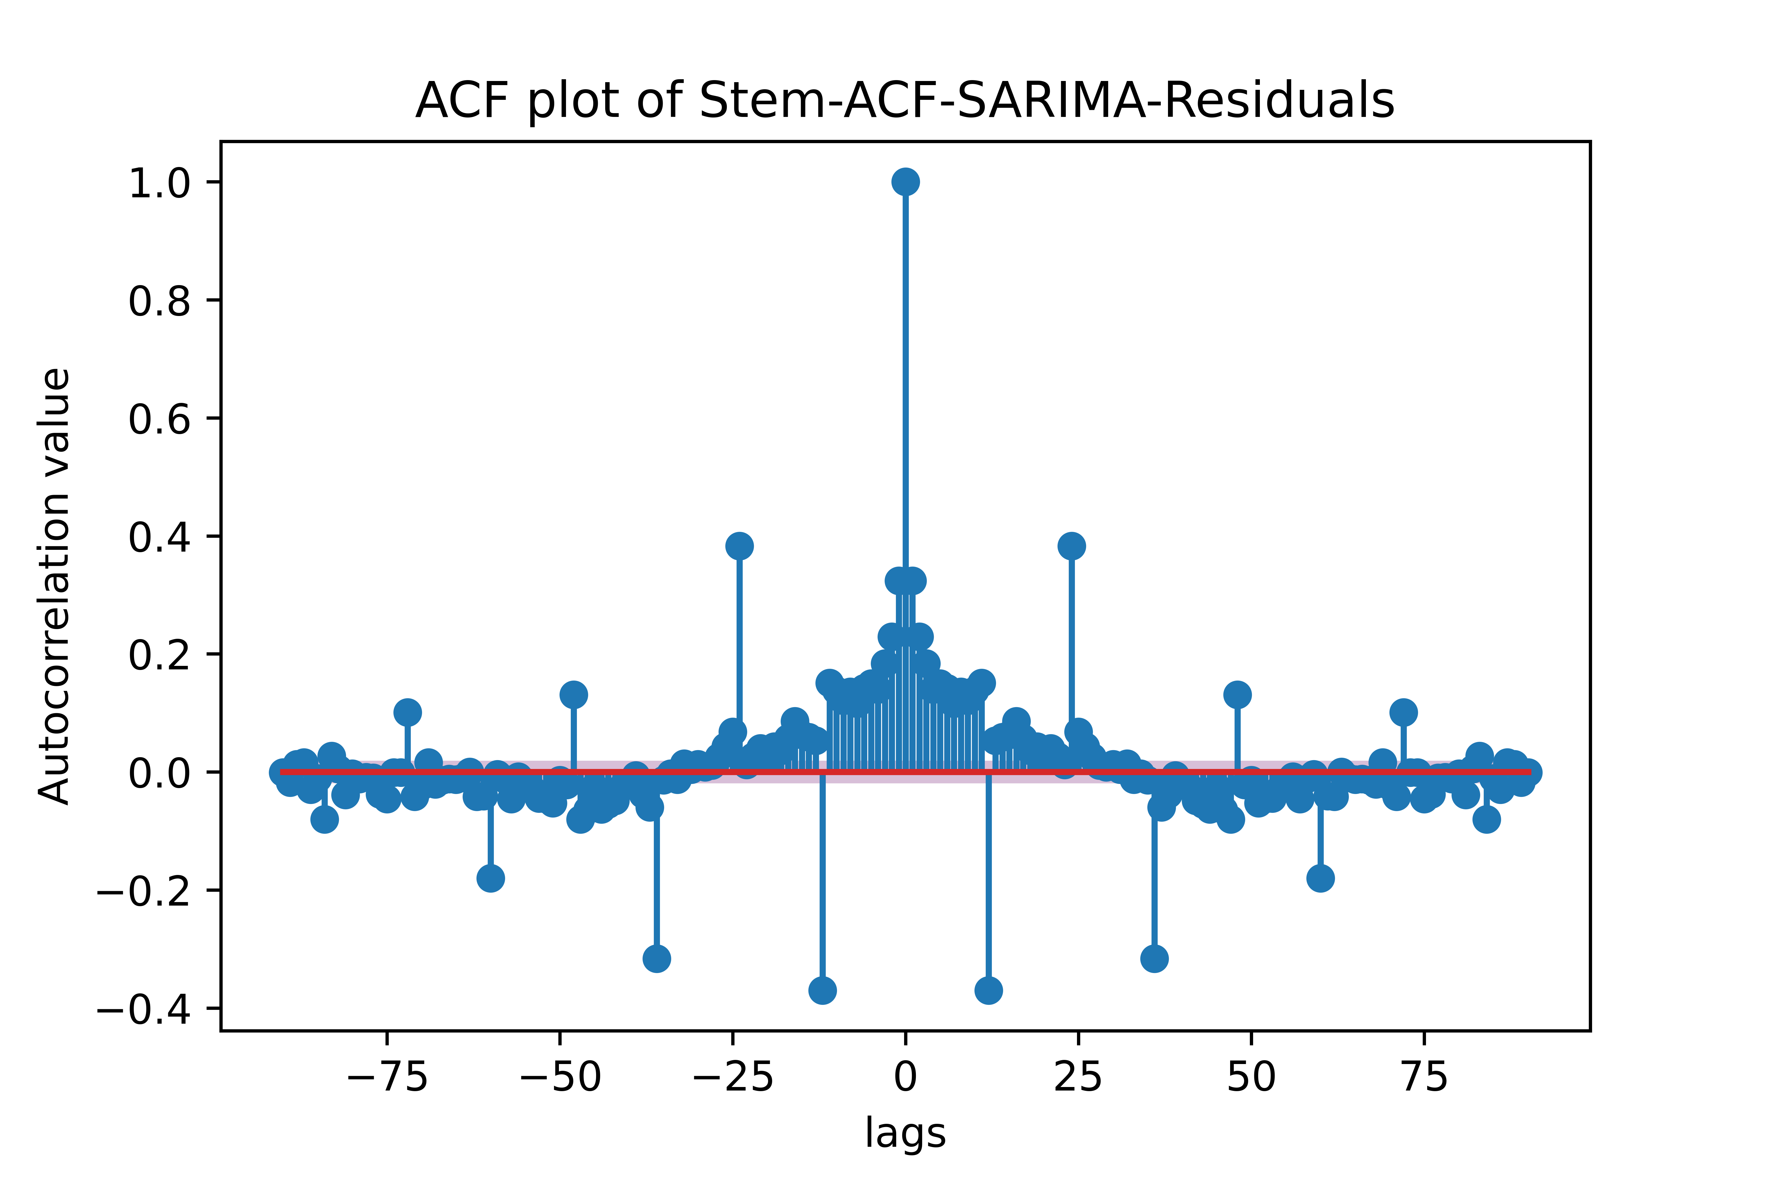
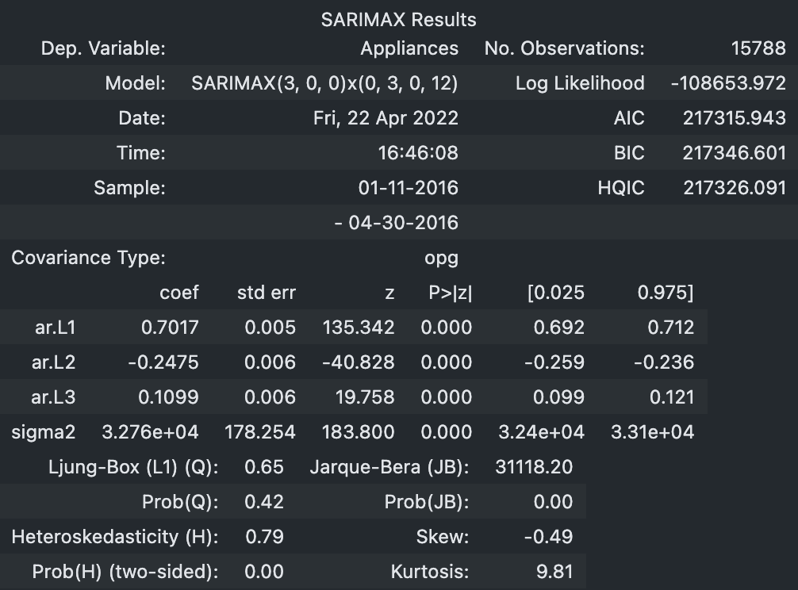
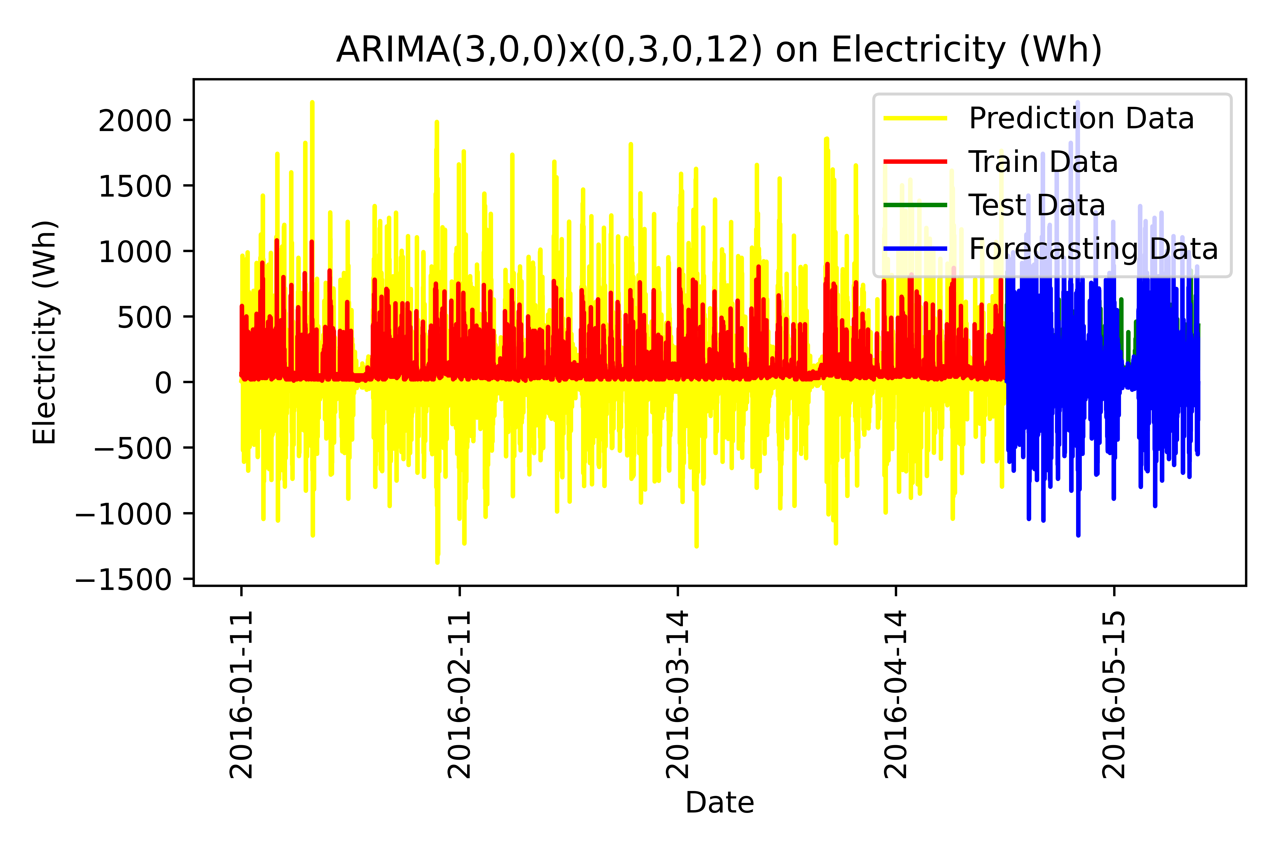
SARIMA: ARIMA(3,0,0)x(0,0,0,12)

Slide 19
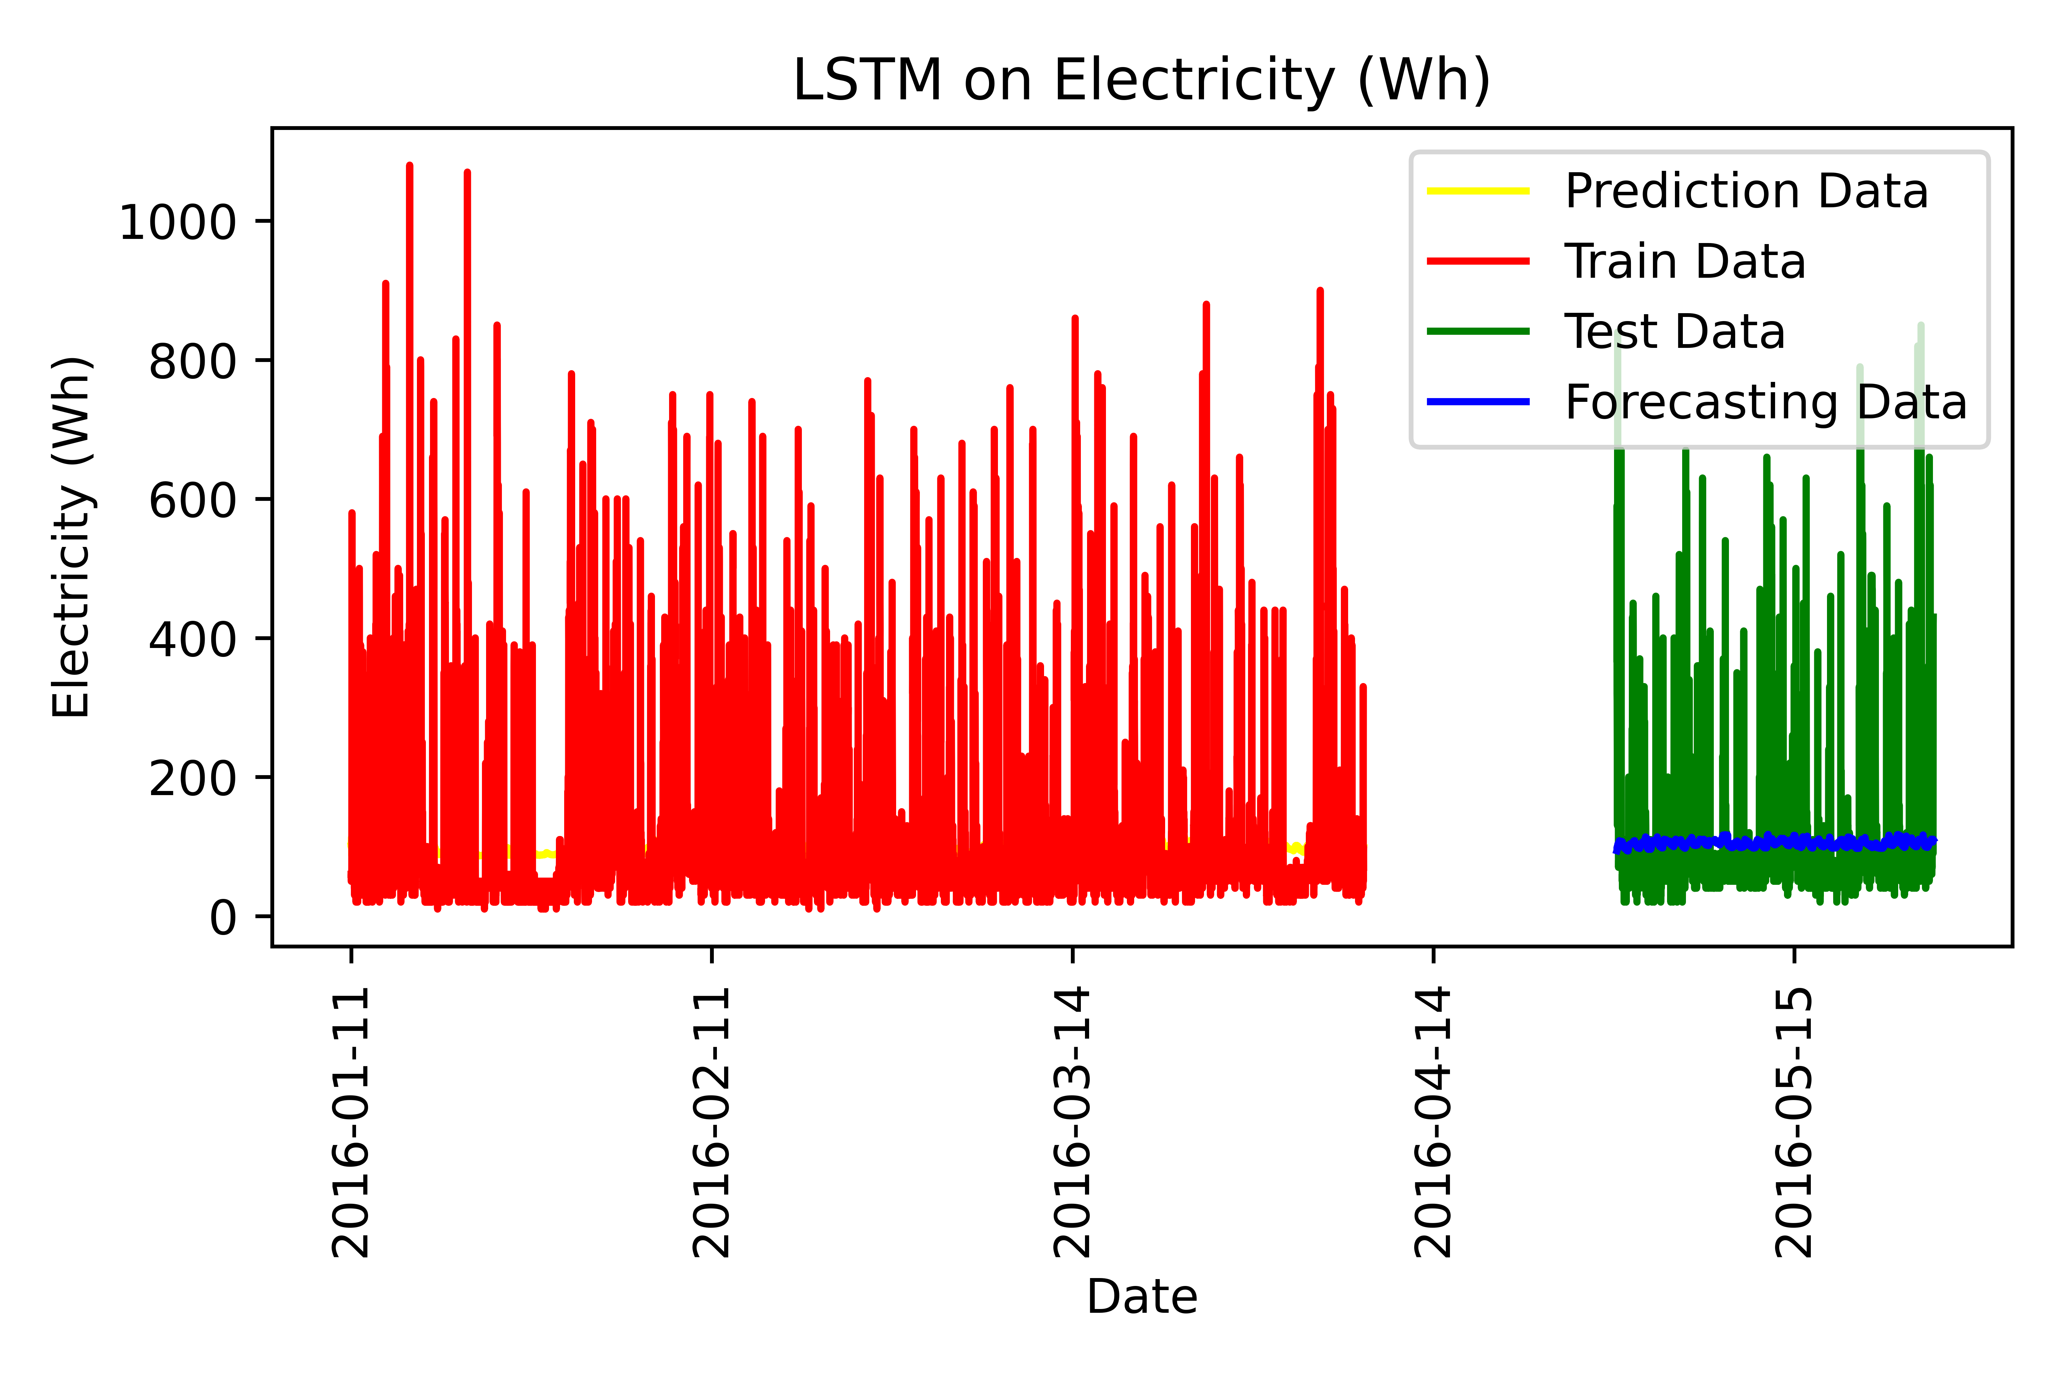
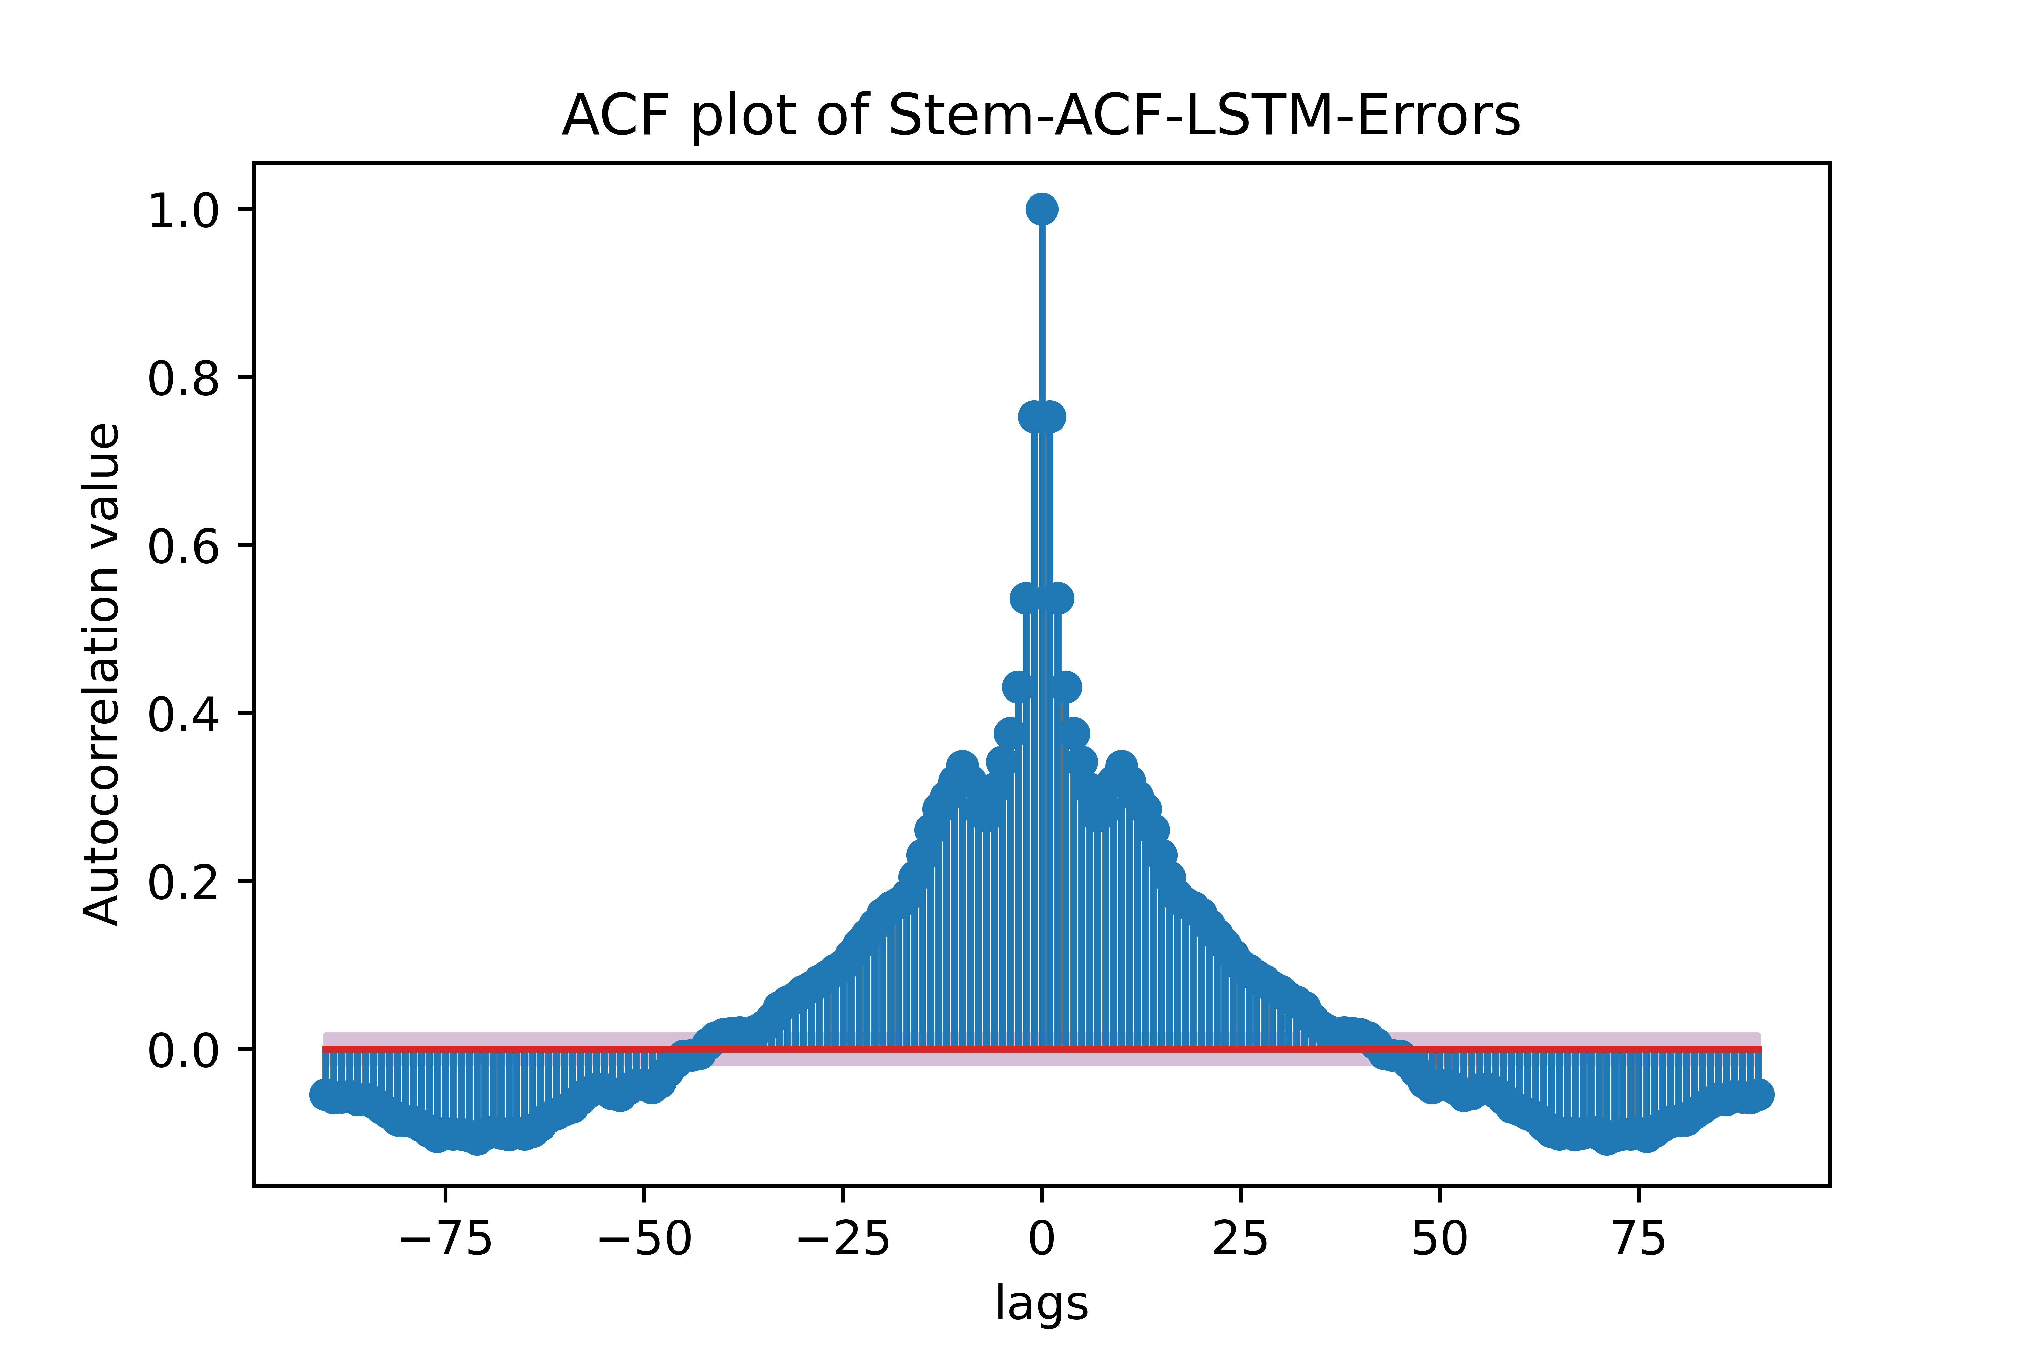
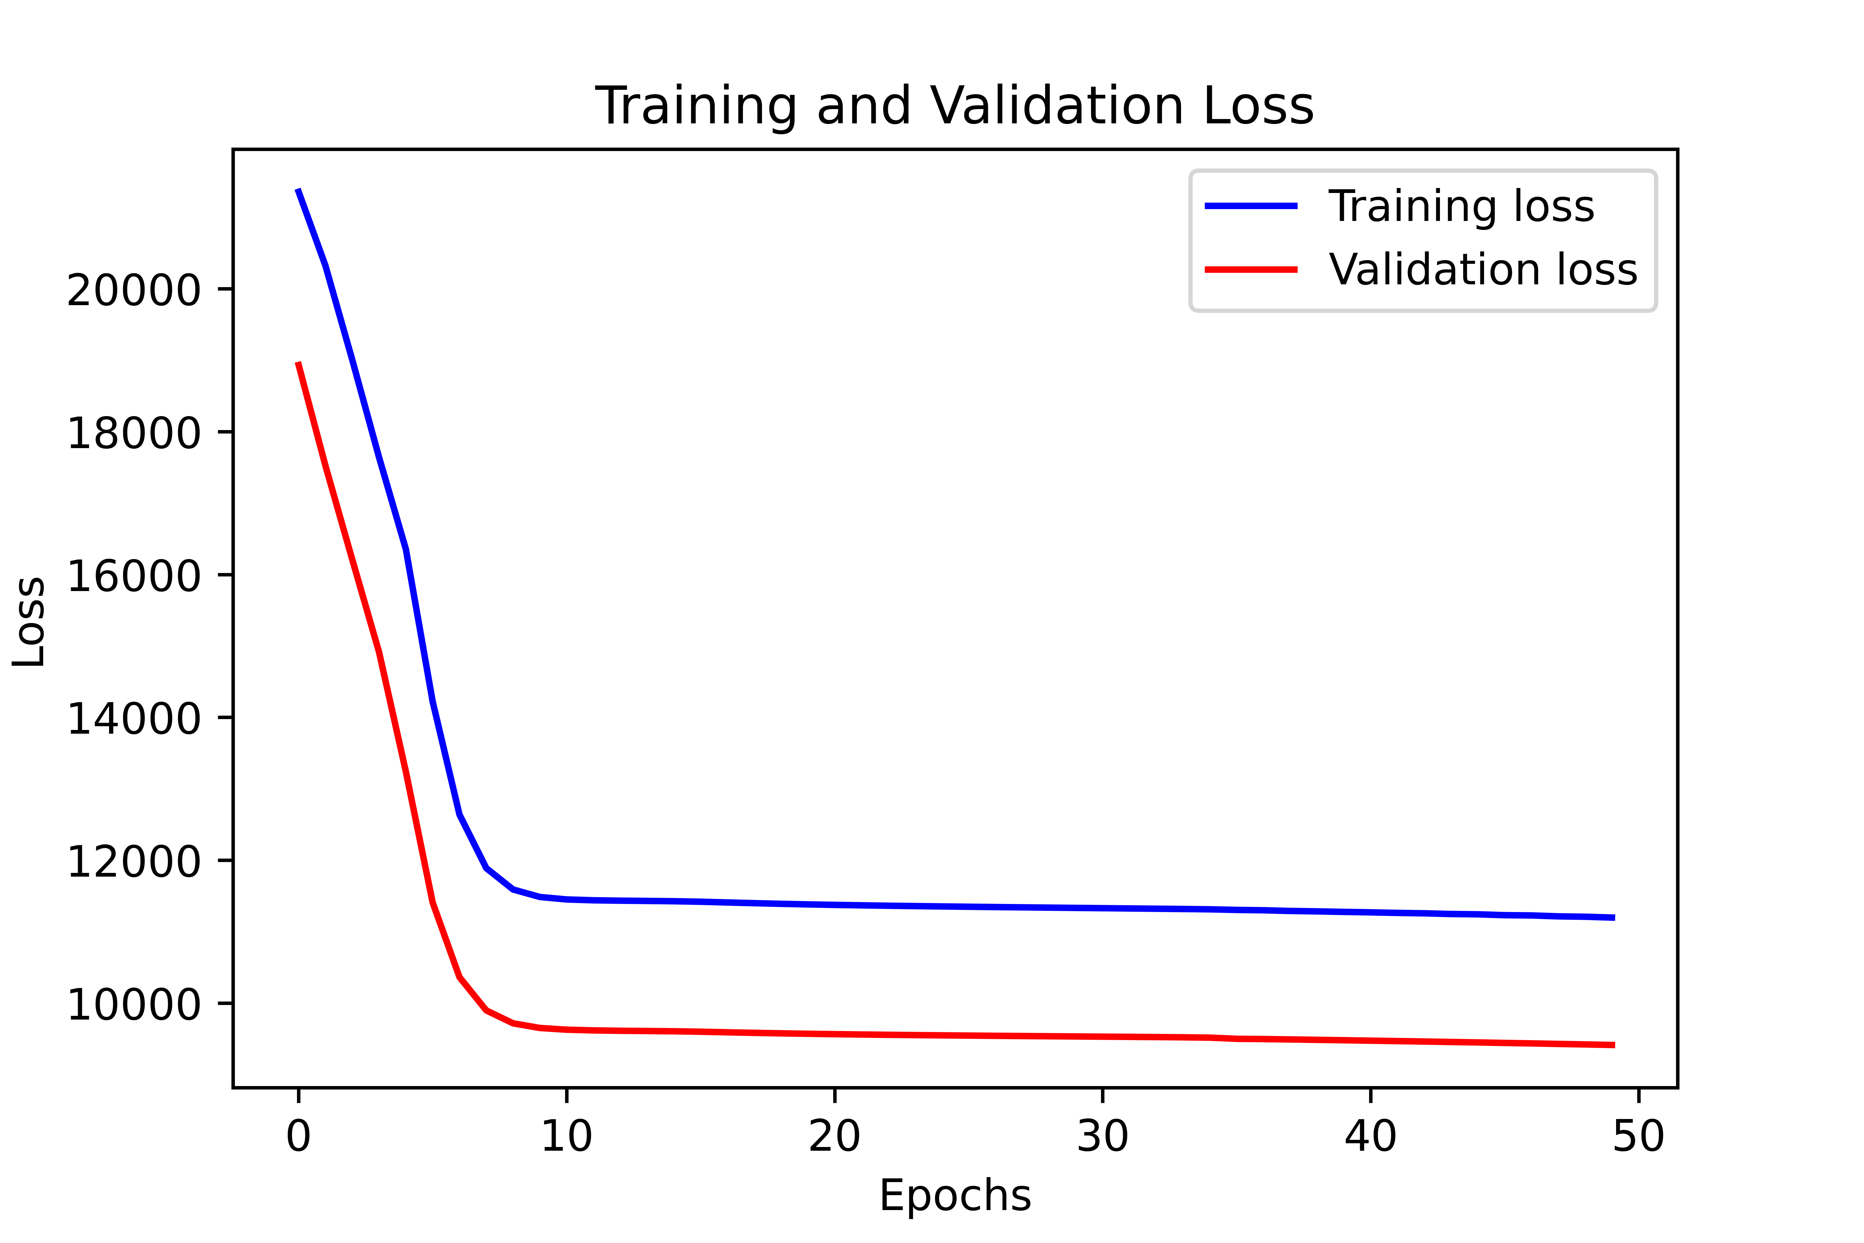
LSTM

Slide 20
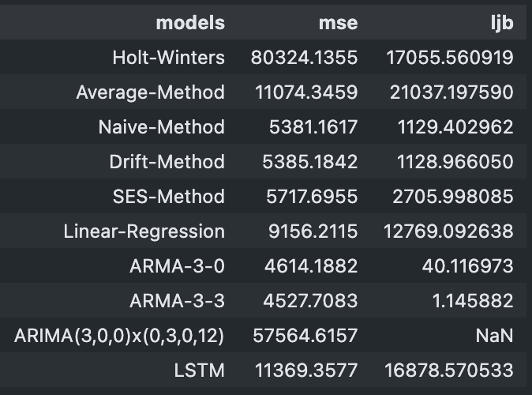
Table of Model Metrics
Winner: ARMA 3-3
Conclusion:
The very high spikes in energy usage means low order ARMA models can follow cyclical trends without considering cyclicality at all

Slide 21
Original

